Slide 1
Psychiatry Integrated Primary Care
Dr.Aseel Omran Alsabbrie
Consultant family Medicine.
MBBCH,MRCGp (int).
Member in Primary Mental Health committee C.A .
Member of the Board of Directors of the KMA
Member of Wonca &WFMH
Member Board of the Association of Family Medicine and General Practitioner.

Slide 2
What is the Psychiatry Integrated Primary Care?
Why Integration in Kuwait?
Common Psychiatric disorders in primary care.

Slide 3
Missing puzzle pieces can cause confusion because the incomplete puzzle can cause you to question the meaning of the pieces you did capture.
Notes:
In other words, there is not a coherent understanding of what is happening because the missing pieces can leave you bewildered.

Slide 4
it was a group of primary care physicians who initially identified the need for mental health integration. They recognized that a number of their patients needed mental health care, but that they were ill-equipped to deal with these problems and there were too few specialists for routine referral. Moreover, specialists were often far from patients’ homes, and seeking services resulted in substantial travel expenses and isolation from family and friends. The primary care physicians realized that they needed training in the management of mental disorders. They also requested better coordination with psychiatrists, nurses, psychologists and social workers, to provide optimal support to patients and families.
The integration of mental health into primary care was driven by practical, theoretical and human rights considerations.

Slide 5
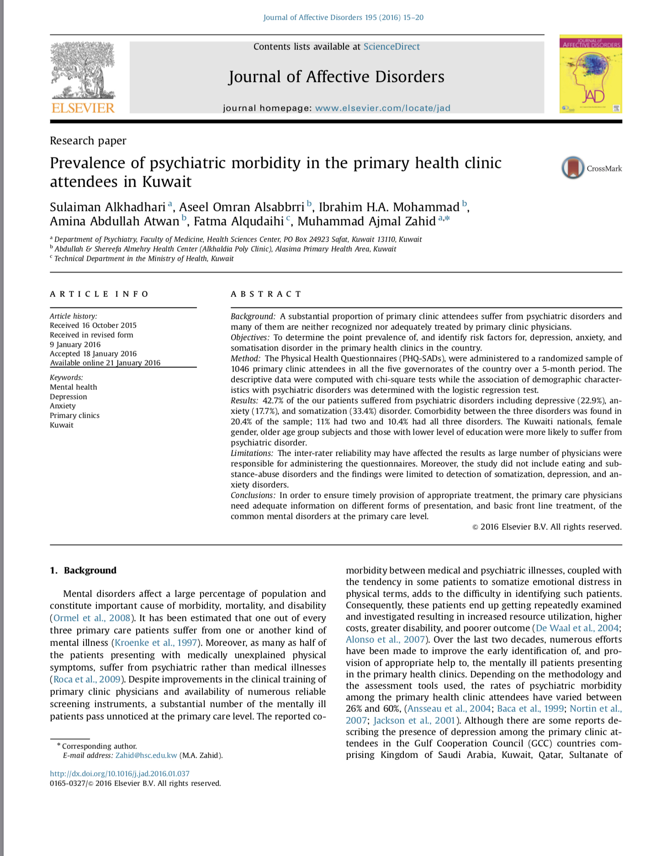
Why Integration in Kuwait?

Slide 6
Integrating mental health services into primary care is the most viable way of closing the treatment gap and ensuring that people get the mental health care they need.
2. Primary care for mental health is affordable, and investments can bring important benefits.
Notes:
1. Mental disorders affect hundreds of millions of people and, if left untreated, create an enormous toll of suffering, disability and economic loss.
2. Despite the potential to successfully treat mental disorders, only a small minority of those in need receive even the most basic treatment.
5. Certain skills and competencies are required to effectively assess, diagnose, treat, support and refer people with mental disorders; it is essential that primary care workers are adequately prepared and supported in their mental health work.

Slide 7
3. To be fully effective and efficient, primary care for mental health must be coordinated with a network of services at different levels of care and complemented by broader health system development.
Notes:
6. There is no single best practice model that can be followed by all countries. Rather, successes have been achieved through sensible local application of broad principles.
7. Integration is most successful when mental health is incorporated into health policy and legislative frameworks and supported by senior leadership, adequate resources, and ongoing governance.

Slide 8
Emergency
KMHC
General Or NCD clinics
Primary Mental health clinics
OPD

Slide 9
نَحْنُ نَقُصُّ عَلَيْكَ أَحْسَنَ الْقَصَصِ بِمَا أَوْحَيْنَا إِلَيْكَ هَذَا الْقُرْآنَ وَإِنْ كُنْتَ مِنْ قَبْلِهِ لَمِنَ الْغَافِلِينَ
Notes:
وأسلوب القصة من الأساليب التي اعتنى القرآن الكريم بها عناية خاصة؛ لما فيها من عنصر التشويق، وجوانب الاتعاظ والاعتبار. وقد ألمح القرآن إلى هذا في أكثر من آية من ذلك قوله تعالى: {فاقصص القصص لعلهم يتفكرون} (الأعراف:176)، إلى غير ذلك من الآيات التي تبين اعتماد القرآن أسلوب القصص، تحقيقاً لمقاصد وأغراض نتبينها

Slide 10
Yosef
Case # 1
45 yr .old kw gentleman
Presented at the end of the day , at 8:45 pm, 21/11/2007. ,with
Fever with rigors
Cough
Sore throat.
Fatigue & tiredness
Blocked nose.

Slide 11
Present history
Social history
Past med history
Productive cough
Fever
Sore throat
Blocked nose
Fatigue & tiredness
Single
Unemployed for the last 8 yr.
Heavy smoker 4 p/day
Living with his mother & sisters
Non frequent visitor
No past surgical history
No significant past medical history

Slide 12
Physical examination:
Temp:38.9c
BP: 135/85
Slight yellowish sclera.
Throat: oral thrush with bad dental hygiene & moderate congested throat without pus neither lYmph node
Chest: fair air entry .
Congested nasal mucosa .

Slide 13
؟؟؟؟؟؟؟؟

Slide 14
Management
Clarification : URTI
Reassurance :
Advice : stop smoking
Prescriptions : decongestion & pain killer
Referral : PMH clinic
Investigation: CBC, LFT, chest x-ray
Observations : close follow up
Prevention :influenza vaccine

Slide 15
P.m.h. Clinic
Pho-15 sad : pho-9= 24 GAD-7 =21 Pho-15= 20
Mood questioner: serious problem +
CBC ,TSH ,lft , vitamin B12, vitamin d ,lipid profile : t.chol=6.5
Family dynamics : oldest son in the family :1 brother ,4 sisters
Detailed of social event preceded his symptoms. death of his father 1998, fired from work 1998

Slide 16
What is your differential diagnosis?
MDD.
Bipolar disorder depressive phase.
Borderline personality disorder.
PTSD

Slide 17
Manic episode 1990-1998
Bipolar Major depression with suicidal attempts (Bipolar disorder I ) 1998-2007
Substance miss used.1998.
Hypomanic episodes 2007-2011
Psoriasis.
Bipolar Manic phase. 2012-2015
April 2015. Committed suicide
Died after drinking very erosive liquid which lead to upper GI bleeding ,hepatorenal failure.

Slide 18
Bipolar disorder is a mood disorder that is characterized by episodes of mania , hypomania and major depression
Bipolar I disorder : manic episodes and nearly always experience major depressive and hypomanic episodes
Bipolar II disorder is marked by at least one hypomanic episode, at least one major depressive episode, and the absence of manic episodes

Slide 19
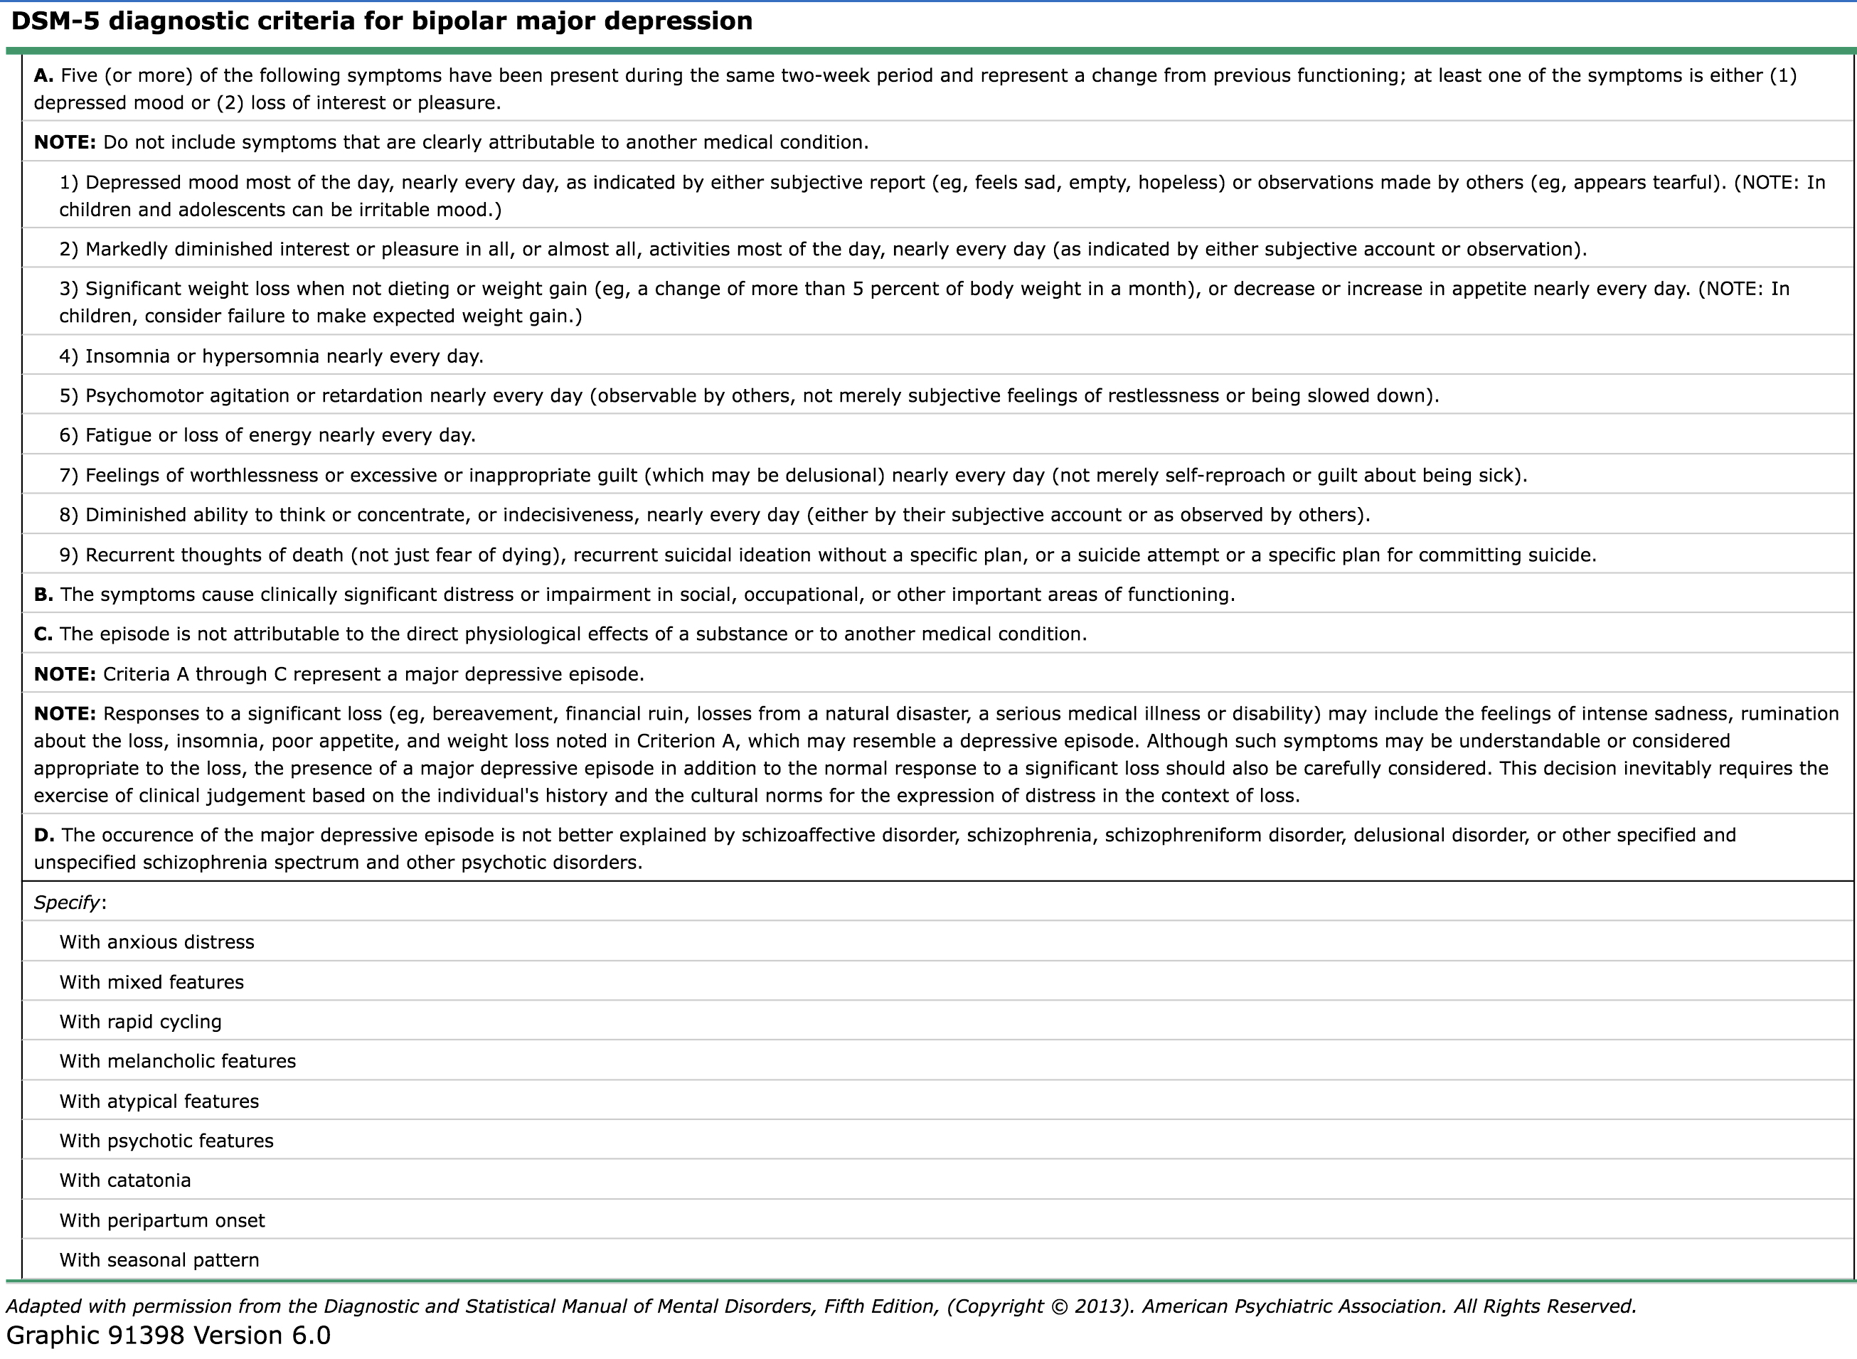

Slide 20
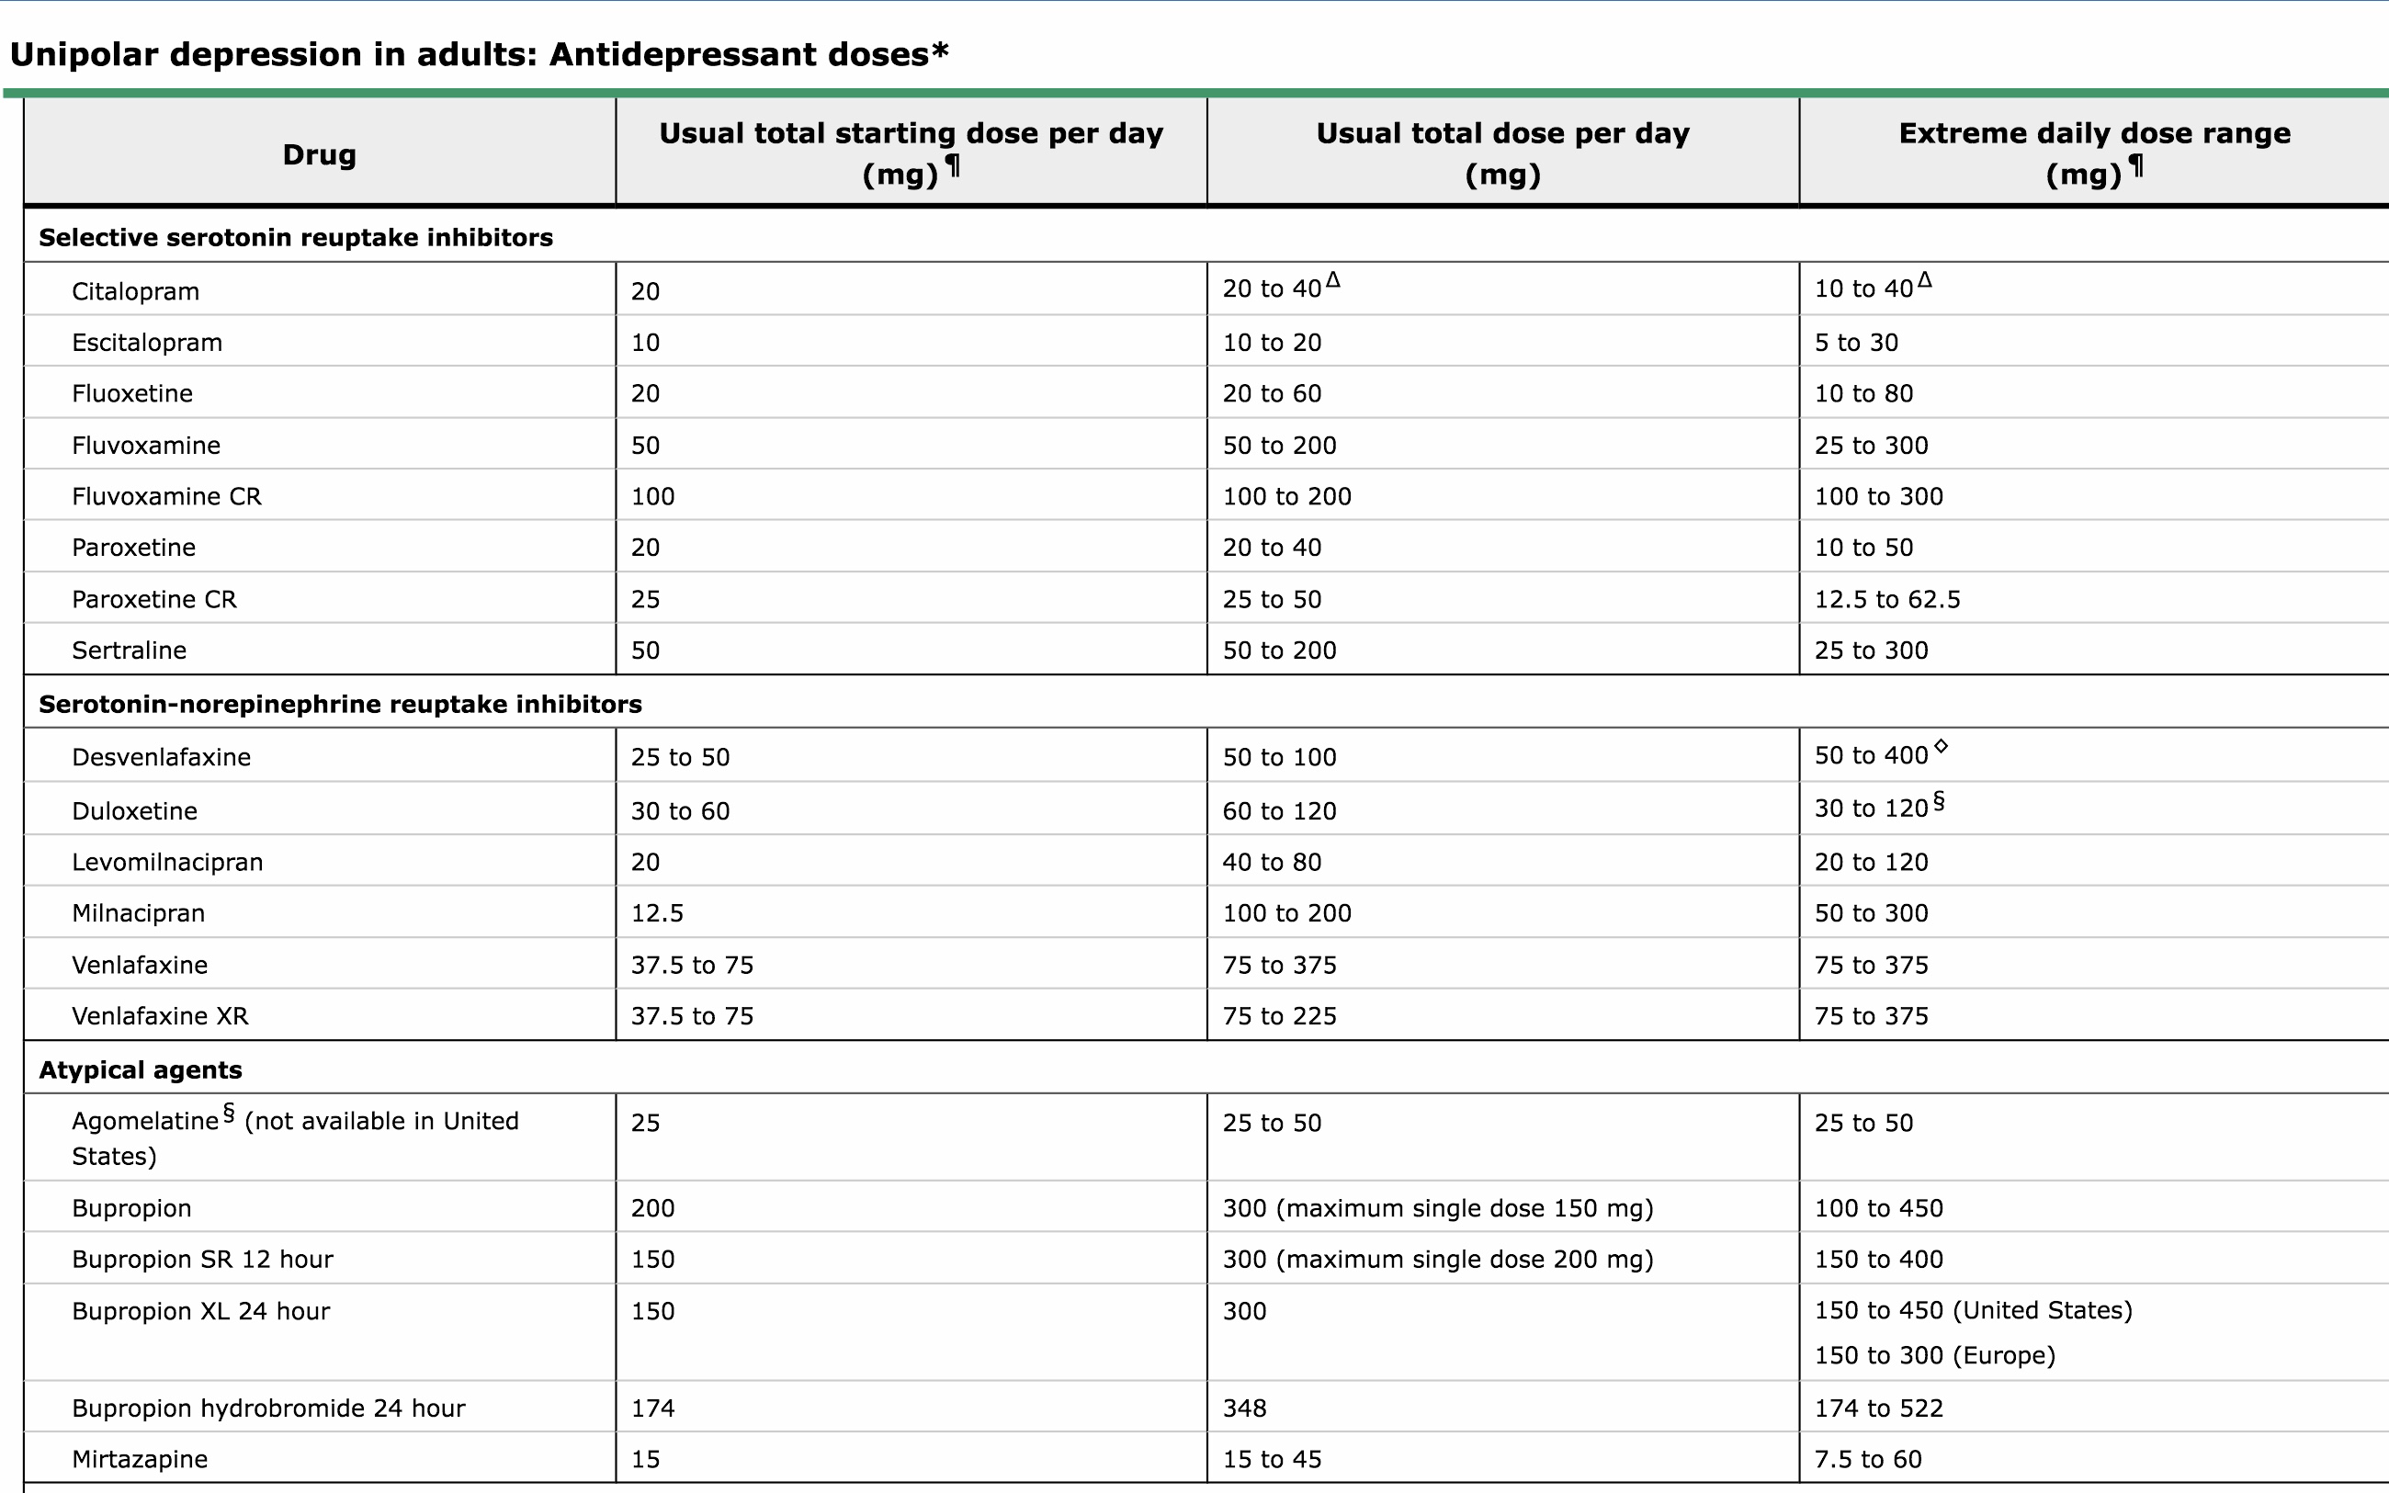
The use of antidepressants for acute and maintenance treatment of bipolar depression is controversial because of concerns that these drugs are not effective and may harm patients by causing switches from depression to mania as well as rapid cycling .
Notes:
The use of antidepressants for acute and maintenance treatment of bipolar depression is controversial because of concerns that these drugs are not effective and may harm patients by causing switches from depression to mania as well as rapid cycling .

Slide 21
INDICATIONS FOR REFERRAL to psychiatric OPD :
Suicidal ideation and behavior
Psychotic features (eg, auditory hallucinations commanding patients to kill themselves
Fluctuating symptoms
Impulsive and dangerous behavior
Functional impairment
Comorbid psychopathology (eg, anxiety disorders and substance use disorders)
Multiple (eg, two to four) failed medication trials
Administration of adjunctive psychotherapy
Recurrence of mood episodesPrimary care clinicians who refer patients to specialists are encouraged to remain involved in management.
Notes:
Although some primary care clinicians have the requisite training and experience to manage bipolar disorder, many patients are referred to psychiatrists and other mental health clinicians if these specialists are available. Common indications for referral include:
General internists and other clinicians can help educate patients and families about pharmacotherapy and reinforce the need for adherence, and typically collaborate in evaluating patients prior to treatment and monitoring vital signs, weight, height, and waist size during treatment.

Slide 22
Notes:
“The sadness will last forever” - suicide letter by Vincent Van Gogh
Key massage:
Don’t forget bipolar major depression episode
Ask about suicide thoughts & attempts directly.
It’s not only URTI

Slide 23
Last patient in the diabetic clinic January 2017 Hana 48 yr. Kw
Case # 2
I’M fine can you repeat my treatment only .
By the way I have dysuria.

Slide 24
Present history
Social history
Past medical history
Recurrent dysurea,
dark urine with bad smell
Suprapubic abdomenal pain
Numbness in left l.l
48 yr.old female
Biomedical engineer., studying master degree but dropped course 1 yr
Married with 6 children youngest one has ADHD with learning disabilities.
Hypertension on micardis 40/12.5 mg
Hypercholestremia on Lipitor’s 20 mg
Diabetes m.on : novorapid 20 TDS, Lantau 50 units, , januvia 100 mg.

Slide 25
Physical examination
Bp=150/110
Afebrile
Rbs=15 Molina/l
Pale with depressed mood

Slide 27
Management
Clarification
Reassurance
Advice
Prescriptions
Referral
Investigation
Observations
prevention

Slide 28
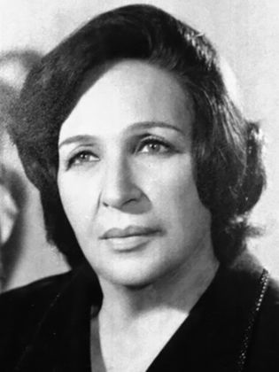
DM. Type1,2015
Diabetic retinopathy Nephropathy 2018.
Child abuse by her mother Domestic violence 2001-2012 (physical separation from her husband)
MDD 2017-2018
Operated disc prolapse L3-S1 with complication of drop foot.Dec/2018
Dysthymia.2019

Slide 29
Persistent depressive disorder (dysthymia) is diagnosed in patients with depressed mood for at least two years that is accompanied by at least two of the following symptoms: decreased or increased appetite, insomnia or hypersomnia, low energy, poor self-esteem, poor concentration, and hopelessness .
Notes:
In patients with general medical illnesses such as diabetes or coronary heart disease, the prevalence of major depression is estimated at 10 to 20 percent .In addition, disability due to depression is common. The World Health Organization ranks unipolar major depression as the 11th greatest cause of disability and mortality in the world, among 291 diseases and causes of injury and dysthymia ranks 20th

Slide 30
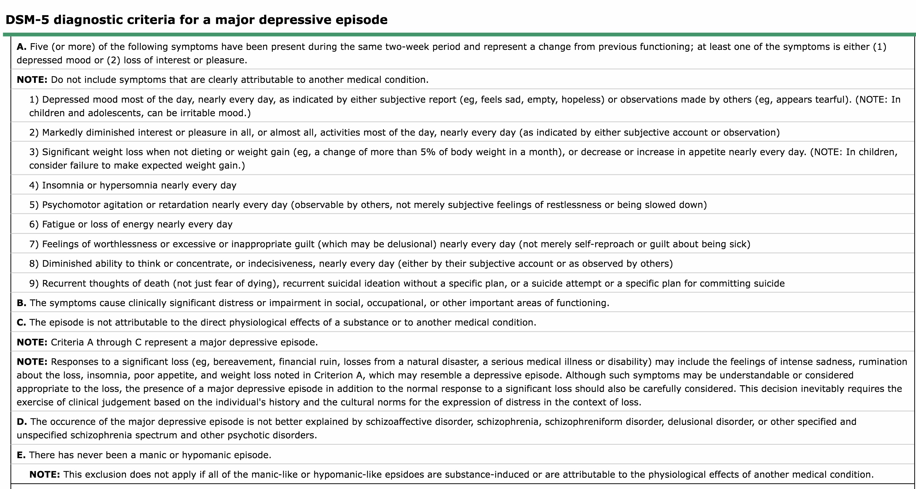

Slide 31
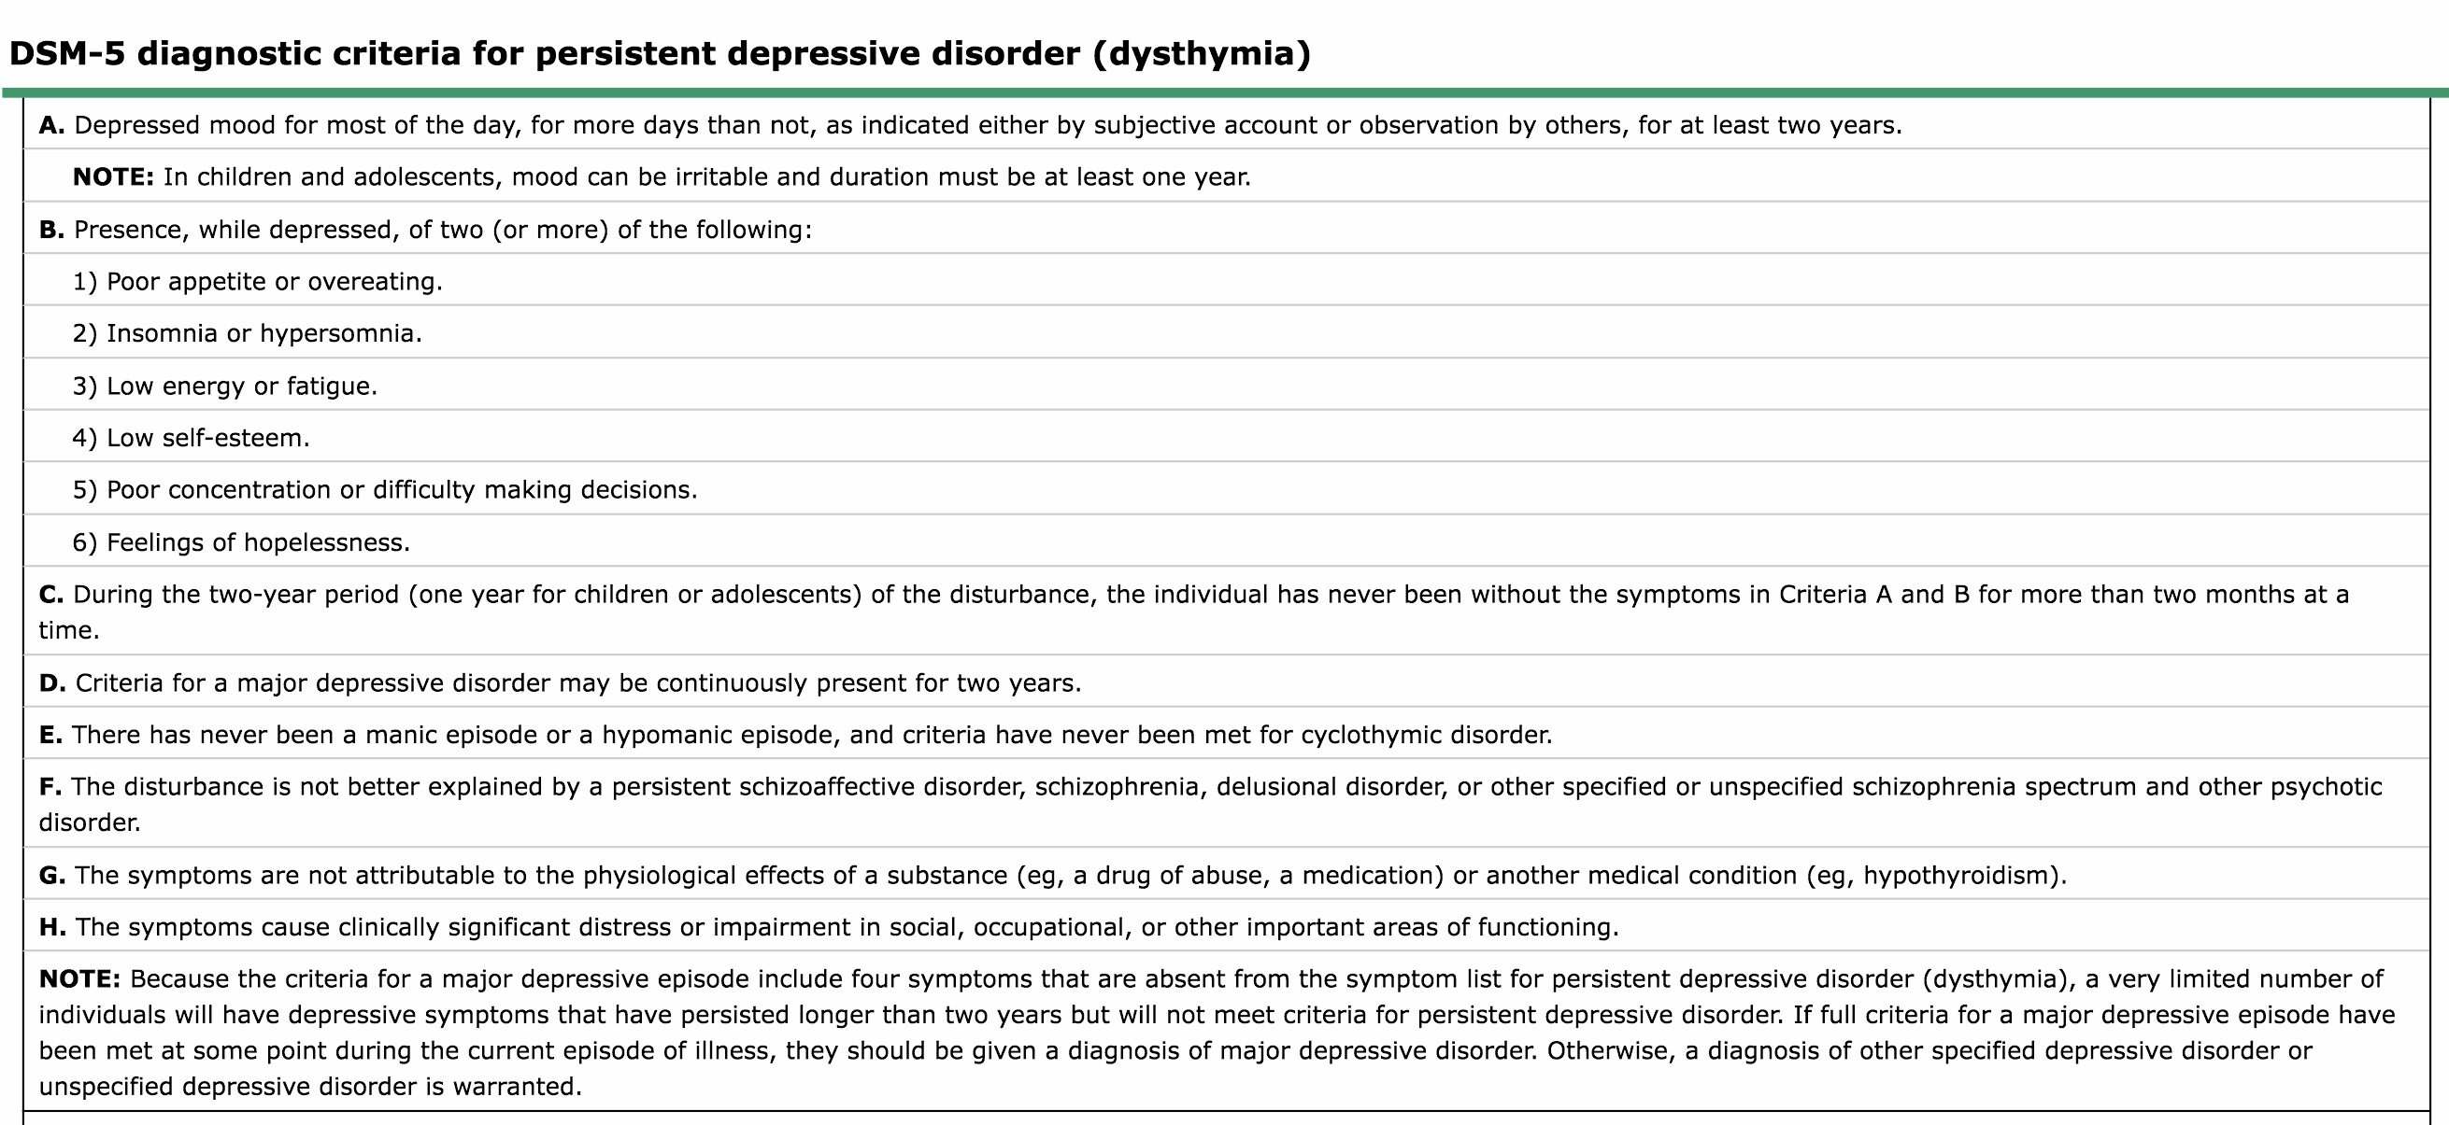
Notes:
Unipolar major depression (major depressive disorder) is diagnosed in patients who have suffered at least one major depressive episode and have no history of mania or hypomania (table 1) [5]. A major depressive episode is a period lasting at least two weeks, with five or more of the following symptoms: depressed mood, anhedonia, insomnia or hypersomnia, change in appetite or weight, psychomotor retardation or agitation, low energy, poor concentration, thoughts of worthlessness or guilt, and recurrent thoughts about death or suicide; at least one of the symptoms must be depressed mood or anhedonia. (See "Unipolar depression in adults: Assessment and diagnosis", section on 'Unipolar major depression'.)OVERVIEW OF TREATMENTMany studies describe treatment outcome using the terms “response” and “remission,” based upon the amount of improvement from baseline on a clinician administered depression rating scale [6,7]:●Response – Improvement ≥50 percent but less than the threshold for remission.●Remission – Depression rating scale score less than or equal to a specific cutoff that defines the normal range. As an example, studies using the 17 item Hamilton Rating Scale for Depression (form 1A-C) or the Montgomery-Asberg Depression Rating Scale (figure 1A-C) often define remission as a score ≤7, while studies using the Patient Health Questionnaire – Nine Item (PHQ-9) (table 2) often define remission as a score <5.The goal of initial treatment for depression is symptom remission and restoring baseline functioning [8-10]. In the prospective Sequenced Treatment Alternatives to Relieve Depression (STAR*D) study, 3671 outpatients with unipolar major depression who improved following treatment with pharmacotherapy and/or psychotherapy were subsequently followed for up to 12 months [11]. Relapse appeared to occur less frequently in patients who remitted, compared with patients who responded but did not remit.We suggest that clinicians monitor treatment outcomes with patient self-report scales such as the Patient Health Questionnaire – Nine Item (table 2). (See "Using scales to monitor symptoms and treat depression (measurement based care)", section on 'Patient Health Questionnaire - Nine Item'.)Choosing a treatment regimen — For the initial treatment of unipolar major depression, we suggest the combination of pharmacotherapy and psychotherapy, based upon randomized trials that found combination treatment was more effective than either of these treatments alone [12,13]. However, clinical trials have not established the superiority of any specific medication/psychotherapy combination [8]. Rather, clinicians select each modality using the same principles when choosing a monotherapy. (See 'Selecting a specific antidepressant' below and 'Selecting a specific psychotherapy' below.)A reasonable alternative to combination therapy for the initial treatment of major depression is pharmacotherapy alone or psychotherapy alone; antidepressants and psychotherapy have each demonstrated efficacy as monotherapy in randomized trials [14]. In addition, randomized trials that compared pharmacotherapy alone with psychotherapy alone in depressed outpatients found that the benefits of each modality were comparable [15].Antidepressants alone have been studied and used more often than combination treatment or psychotherapy alone because antidepressants are generally more available and convenient than psychotherapy [8,16], and some patients prefer pharmacotherapy [17]. Other factors to consider in choosing a treatment regimen are comorbidity, psychosocial stressors, and cost.The use of pharmacotherapy plus psychotherapy, pharmacotherapy alone, or psychotherapy alone for unipolar major depression is consistent with practice guidelines from the American Psychiatric Association and the United Kingdom National Institute for Health and Care Excellence (NICE) [8,18]. However, the NICE guidelines recommend psychotherapy for the initial treatment of patients with mild depression, based upon the judgement that the risk benefit ratio for pharmacotherapy does not justify its use for relatively mild symptoms [18].Evidence for the efficacy of combination therapy, pharmacotherapy alone, and psychotherapy alone are discussed elsewhere in this topic. (See 'Efficacy of antidepressants plus psychotherapy' below and 'Efficacy of antidepressants' below and 'Efficacy of psychotherapy' below and 'Efficacy of antidepressants compared with psychotherapy' below.)Efficacy of antidepressants plus psychotherapy — For the initial treatment of unipolar major depression, randomized trials indicate that the combination of pharmacotherapy and psychotherapy (eg, cognitive-behavioral therapy or interpersonal psychotherapy) is more efficacious than either pharmacotherapy alone or psychotherapy alone [12,13]. Evidence supporting the superiority of combination therapy over pharmacotherapy alone for the initial treatment of unipolar major depression includes many randomized trials [15,19]. As an example, a meta-analysis of 25 randomized trials compared combination therapy with antidepressants alone in patients with depressive disorders (n >2000) [12]. The analysis found a significant, clinically small to moderate effect favoring combination therapy. In addition, discontinuation of treatment for any reason was lower with combination treatment (odds ratio 0.7, 95% CI 0.5-0.8). Separate analyses of the three subgroups that received cognitive-behavioral therapy (seven trials), interpersonal psychotherapy (eight trials), or other psychotherapies (10 trials) found that in each case, combined therapy was superior to antidepressants alone.Evidence supporting the superiority of antidepressants plus psychotherapy over psychotherapy alone for the initial treatment of unipolar major depression includes many randomized trials [15,20,21]. As an example, a meta-analysis of 16 randomized trials compared combination treatment with psychotherapy alone in patients with depressive disorders (n >1700) [13]. Recovery was more likely with combination therapy (relative risk 1.3, 95% CI 1.2-1.4). However, one concern that we have in evaluating trials that include psychotherapy is the lack of blinding.Efficacy of antidepressants — Antidepressants can help patients with unipolar major depression [22-24]. Meta-analyses of randomized trials have found that many specific antidepressants, as well as antidepressant classes, are efficacious in unipolar major depression, including agomelatine (not available in the United States) [25], amitriptyline [26], citalopram, [27], duloxetine [28], escitalopram [29], imipramine [30], mirtazapine [31], paroxetine [32], sertraline [33], monoamine oxidase inhibitors [34], selective serotonin reuptake inhibitors [35], and tricyclics [26,30,34-37]. As an example, a meta-analysis of patient-level data from 37 randomized trials (n >8400 patients with major depression) compared either fluoxetine (modal dose 20 mg per day) or venlafaxine (modal dose range 75 to 150 mg per day) with placebo for six weeks; remission occurred in more patients who received active drug than placebo (43 versus 29 percent) [38]. In addition, antidepressants were efficacious regardless of baseline severity. The rate of remission in milder depressive episodes (scores on the Hamilton Rating Scale for Depression ≤19; (form 1A-C)) was greater with active drug than placebo (50 versus 37 percent of patients); the rate of remission in more severe episodes (scores >20) was also greater with active drug than placebo (38 versus 25 percent).The advantage of antidepressants over placebo is typically 2 to 4 points on a standard rating scale, such as the 17-item Hamilton Rating Scale for Depression (form 1A-C), which ranges from 0 to 52 points [39]. As an example, a meta-analysis of patient-level data (37 randomized trials, n >8400 patients with unipolar major depression who were assessed with the Hamilton scale) found that improvement with antidepressants and placebo differed by 3 points [38].The small advantage of antidepressants over placebo in depressed patients is due in part to the nonspecific clinical effects of placebo treatment; receiving placebos in clinical trials is not equivalent to receiving no treatment. Depressed study patients who are treated with placebos receive nonspecific support by meeting regularly with clinicians and research assistants to discuss symptoms and functioning [39]. Placebos may act by instilling hope, raising expectations of improvement, and motivating patients to please investigators [40]. In addition, placebo responses may be related to genetic polymorphisms [41]. The effects of placebos often lead to remission. As an example, a meta-analysis of individual patient data from 37 randomized trials found that among patients with unipolar major depression who were treated with placebo (n >3300), remission occurred in 29 percent [38].Meta-analyses based upon published randomized trials may overestimate the effect of antidepressants because of selective publication of trials (publication bias) [42]. A study of 12 second-generation antidepressants compared drug trials that were published with trials that were registered with the US Food and Drug Administration (FDA); drug companies are required to submit all trials when registering a drug for approval by a regulatory agency [43]. The primary findings included the following:●Of the 74 trials that were registered, 31 percent (23 trials) were not published.●Among the 51 published trials, the results were presented as positive (ie, improvement was greater with the drug than placebo) in 94 percent (48 trials); by contrast, the FDA found that among the 74 registered trials, only 51 percent were positive.●Of the 48 trials that were published as positive, the FDA determined that 23 percent (11 trials) were negative.●The clinical effect of antidepressants was larger in the journal reports than the registered trials.The evidence for the efficacy of antidepressants in primary care patients and in the context of general medical illnesses is discussed separately. (See "Unipolar depression in adult primary care patients and general medical illness: Evidence for the efficacy of initial treatments".)Efficacy of psychotherapy — Psychotherapy is efficacious for the initial treatment of unipolar major depression, based upon numerous randomized trials [44,45]. As an example, a meta-analysis of 92 trials (n >6900 patients) compared psychotherapy (primarily CBT) with a control condition (eg, waiting list or usual care) [46]. The primary findings were as follows:●Remission occurred in more patients treated with psychotherapy, compared with controls (41 versus 21 percent).●Heterogeneity across studies was large; subgroup analyses found that the benefits of psychotherapy were smaller in older patients, and for group therapies (compared with individual therapies).●Number of therapy sessions was not associated with the effect of psychotherapy.It is worth noting that meta-analyses appear to overestimate the clinical benefit of nearly all types of psychotherapy in treating depression [47-49]. These inflated effects may be due to low quality studies, as well as publication bias.Psychotherapy studies are methodologically variable, like pharmacotherapy studies. Some psychotherapy trials are rigorous and specify a priori hypotheses and analytic tests, develop manuals for the psychotherapies and measure adherence on the part of therapists, use active psychotherapy comparators that control for the nonspecific aspects of psychotherapy, use standardized diagnostic criteria and outcome measures, stratify patients on predetermined risk variables, and blind assessment of outcome ratings. Less meticulous studies use open-label designs, less rigorous comparators (eg, treatment as usual or waiting lists), or fail to adequately blind outcome ratings. Although it is commonly believed that blinding of patients in psychotherapy is less successful compared with pharmacotherapy trials, this has never been studied.T

Slide 32
Selecting a drug is based upon other factors :
Safety
Side effect profile
Specific depressive symptoms
Comorbid illnesses
Concurrent medications and potential drug-drug interactions
Ease of use (eg, frequency of administration)
Patient preference or expectations
Cost
Patient response to antidepressants during prior depressive episodes
Family (eg, first degree relative) history of response to antidepressants
Notes:
Given the lack of clear superiority in efficacy among antidepressants, selecting a drug is based upon other factors, such as [8,76]:●Safety●Side effect profile (table 4)●Specific depressive symptoms●Comorbid illnesses●Concurrent medications and potential drug-drug interactions●Ease of use (eg, frequency of administration)●Patient preference or expectations●Cost●Patient response to antidepressants during prior depressive episodes●Family (eg, first degree relative) history of response to antidepressantsAs an example, bupropion is useful for patients who prefer to avoid sexual dysfunction or want treatment for comorbid tobacco dependence, citalopram and escitalopram may be less likely to cause drug-drug interactions, and mirtazapine is often not used for patients who want to avoid weight gain [70,73,77]. In addition, bupropion may be less effective for patients with co-occurring anxiety [78]. (See "Sexual dysfunction caused by selective serotonin reuptake inhibitors (SSRIs): Management" and "Pharmacotherapy for smoking cessation in adults", section on 'Bupropion' and "Selective serotonin reuptake inhibitors: Pharmacology, administration, and side effects", section on 'Drug-drug interactions' and 'Side effects' below.)Specific interactions between antidepressants and concomitant medications can be determined using the drug interactions tool (Lexi-Interact Online) included in UpToDate. This tool can be accessed from the UpToDate online search page or through the individual drug information topics in the section on Drug interactions.Patient response to antidepressants during prior episodes and family history of response to antidepressants are often used in choosing an antidepressant. However, there is little evidence that patient outcomes are improved by selecting an antidepressant on the basis of these factors.Clinicians should also bear in mind that nonspecific factors (eg, conveying empathy, establishing rapport, developing a therapeutic alliance and sense of collaboration, and instilling hope) may affect patient outcomes as much as the choice of antidepressant [39].One preliminary study found that low baseline levels of C reactive protein (<1 mg/L) were associated with a better response to escitalopram than nortriptyline, whereas higher baseline levels were associated with a better response to nortriptyline [79]. Nevertheless, the use of biomarkers to select initial treatment for depression is not standard practice.Side effects — For initial treatment of depression, it is important to select medications that patients can tolerate at doses sufficient to achieve remission. Self-report scales are available for eliciting antidepressants side effects during treatment. (See "Using scales to monitor symptoms and treat depression (measurement based care)", section on 'Adverse side effects scale'.)Although some adverse effects (eg, gastrointestinal toxicity) (table 4) are common across second-generation antidepressants, the incidence of specific side effects during short-term treatment (eg, 6 to 12 weeks) differs among drugs [70,73]:●Diarrhea occurs more often with sertraline than bupropion, citalopram, fluoxetine, fluvoxamine, mirtazapine, nefazodone, paroxetine, and venlafaxine (16 versus 8 percent of patients).●Nausea and vomiting occurs more often with venlafaxine than SSRIs as a class (33 versus 22 percent).●Sexual dysfunction occurs less often with bupropion than escitalopram, fluoxetine, paroxetine, and sertraline (6 versus 16 percent; paroxetine is especially problematic). (See "Sexual dysfunction caused by selective serotonin reuptake inhibitors (SSRIs): Management".)●Somnolence occurs more often with trazodone than bupropion, fluoxetine, mirtazapine, paroxetine, and venlafaxine (42 versus 25 percent).●Weight gain is greater with mirtazapine (0.8 to 3.0 kg after six to eight weeks of treatment) than fluoxetine, paroxetine, trazodone, and venlafaxine.

Slide 33
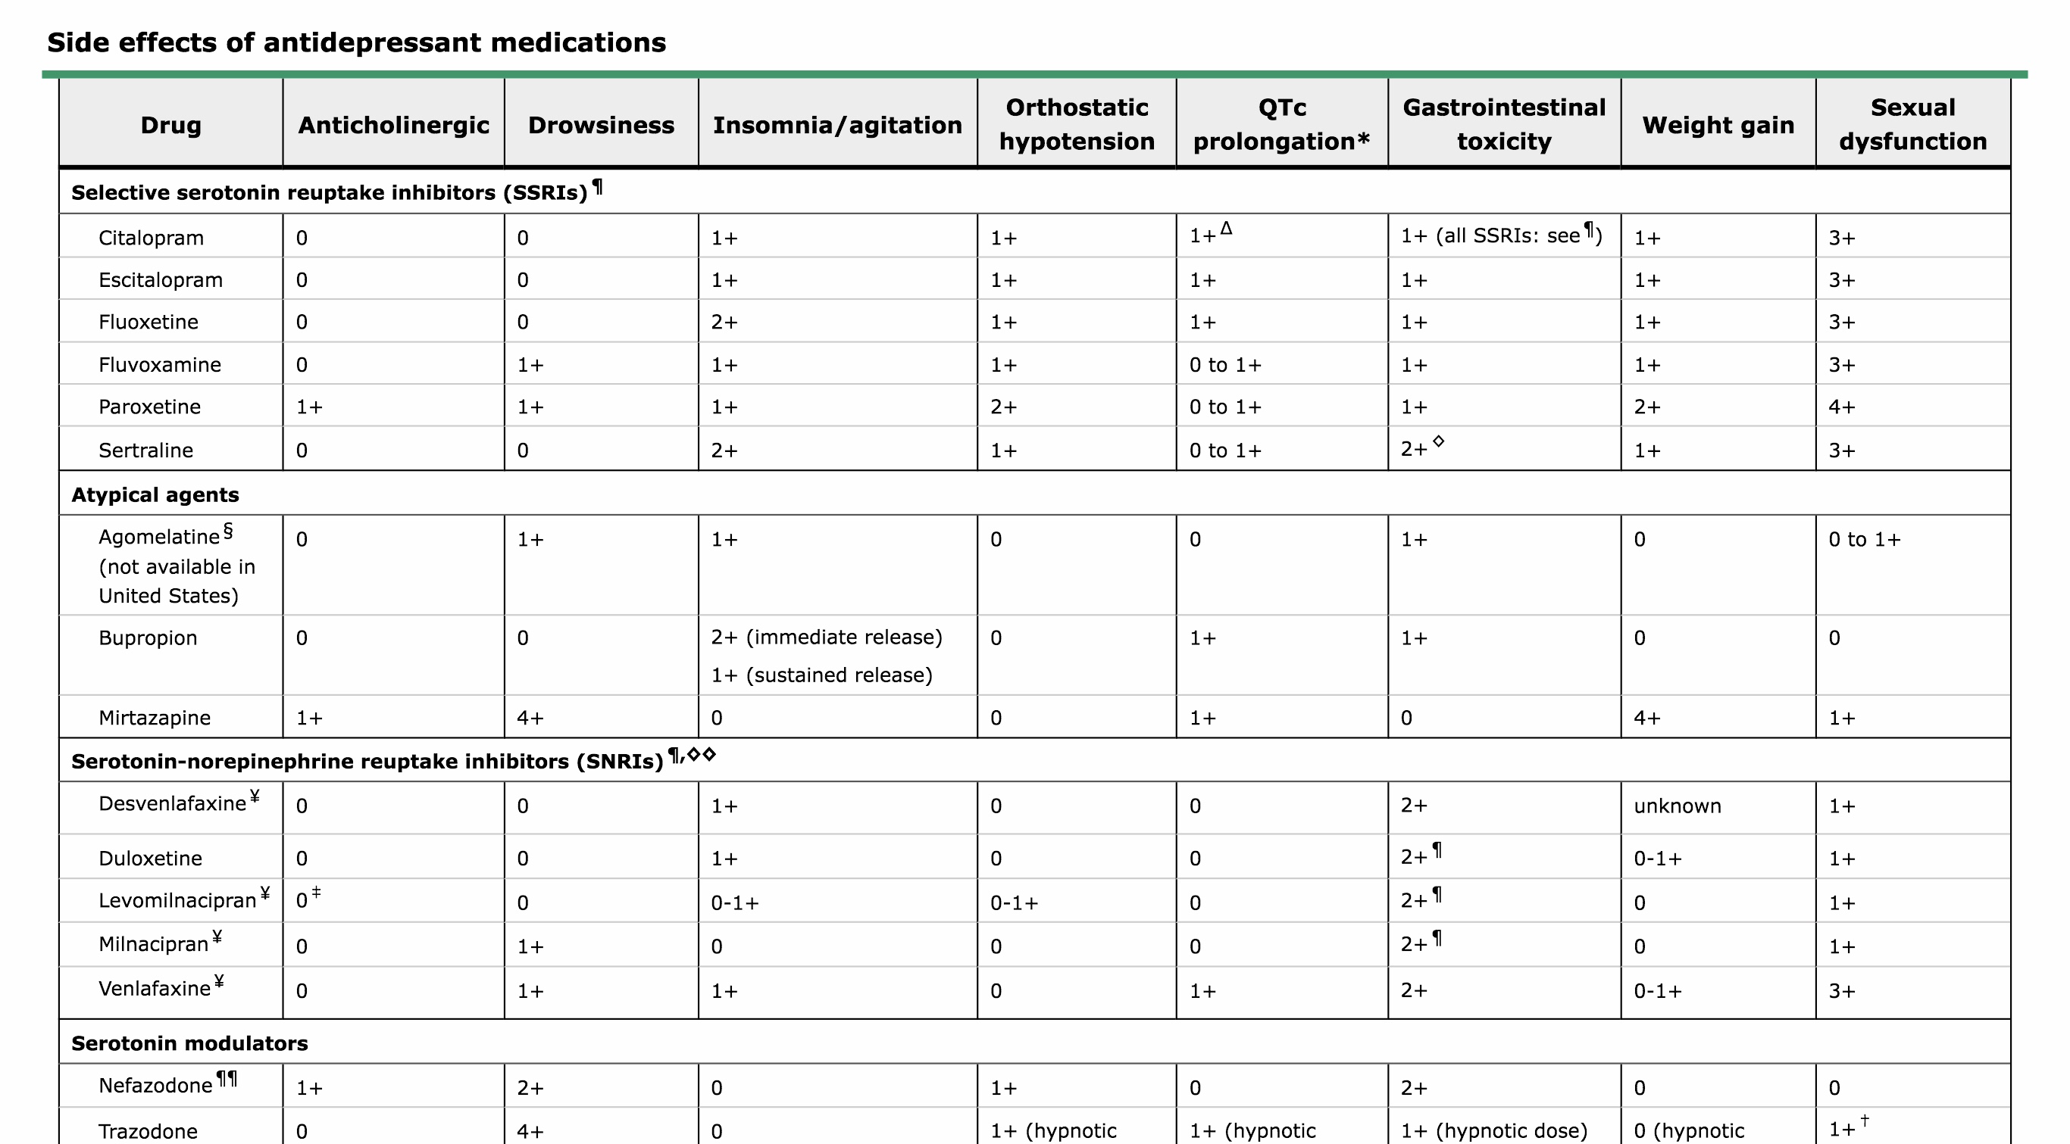
Notes:
Diarrhea occurs more often with sertraline than bupropion, citalopram, fluoxetine, fluvoxamine, mirtazapine, nefazodone, paroxetine, and venlafaxine (16 versus 8 percent of patients)
.●Nausea and vomiting occurs more often with venlafaxine than SSRIs as a class (33 versus 22 percent).
●Sexual dysfunction occurs less often with bupropion than escitalopram, fluoxetine, paroxetine, and sertraline (6 versus 16 percent; paroxetine is especially problematic). (See "Sexual dysfunction caused by selective serotonin reuptake inhibitors (SSRIs): Management".)
●Somnolence occurs more often with trazodone than bupropion, fluoxetine, mirtazapine, paroxetine, and venlafaxine (42 versus 25 percent).
●Weight gain is greater with mirtazapine (0.8 to 3.0 kg after six to eight weeks of treatment) than fluoxetine, paroxetine, trazodone, and venlafaxine.Although antidepressants may be associated with an increased risk of diabetes, the evidence is not compelling and the possible association should not deter clinicians from using antidepressants when indicated

Slide 34
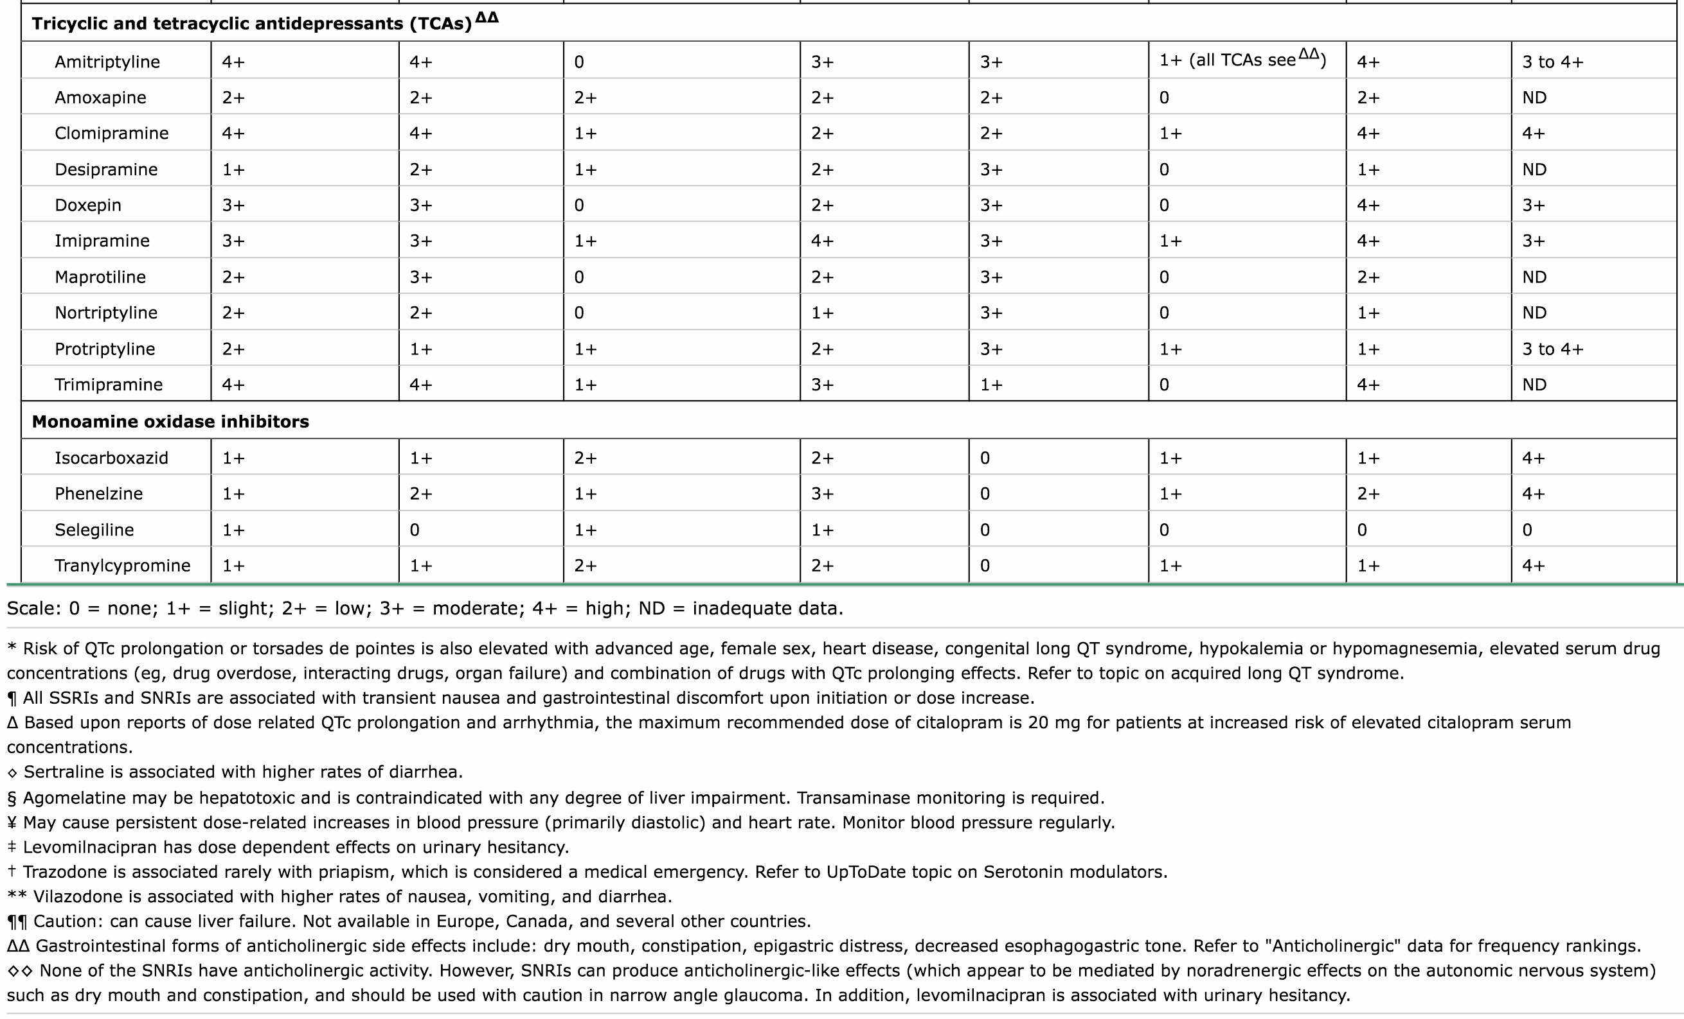

Slide 35
Notes:
●Response – Improvement ≥50 percent but less than the threshold for remission
●Remission – Depression rating scale score less than or equal to a specific cutoff that defines the normal range
Recovery — The median time to recovery from a major depressive episode in prospective observational studies is approximately 20 weeks [
recovery is used to indicate the resolution of a depressive episode .
Although different definitions of recovery exist, many long-term observational studies require at least two consecutive months with no more than one or two mild symptoms of depression and no impairment of psychosocial functioning.
The risk of recurrence appears to be greatest in the first few months after recovery from a major depressive episode. Thereafter, the probability of recurrence progressively decreases as the duration of recovery (wellness) increases.

Slide 36
Major Depressive disorders &the five R
Response : Improvement ≥50 percent but less than the threshold for remission
Remission : Depression rating scale score less than or equal to a specific cutoff that defines the normal range
Recovery :The median time to recovery from a major depressive episode is approximately 20 weeks . It include both functional & syndromal recovery.
Notes:
The delay in functional recovery was attributed primarily to subsyndromal symptoms, and the persistence of these symptoms speaks to the need for continuation treatment.

Slide 37
Functioning :functional recovery often takes longer than syndromal recovery
, functional recovery lagged behind syndromal recovery by approximately one year .
Quality of life : Depression is associated with impaired quality of life, which refers to subjective satisfaction with one’s physical, psychological, and social functioning. Quality of life may remain impaired despite resolution of the depressive syndrome.
Notes:
Functioning — Although psychosocial functioning typically improves in patients who recover from a major depressive episode [89], functional recovery often takes longer than syndromal recovery [90]. As an example, a prospective study of patients with recurrent unipolar depression (n >1000) found that on average, functional recovery lagged behind syndromal recovery by approximately one year [91]. The delay in functional recovery was attributed primarily to subsyndromal symptoms, and the persistence of these symptoms speaks to the need for continuation treatment.Additional information about functional impairment in unipolar depression is discussed separately. (See "Unipolar depression in adults: Clinical features", section on 'Functional impairment'.)Quality of life — Depression is associated with impaired quality of life, which refers to subjective satisfaction with one’s physical, psychological, and social functioning. Quality of life may remain impaired despite resolution of the depressive syndrome. As an example, the Sequenced Treatment Alternatives to Relieve Depression (STAR*D) study prospectively administered citalopram to patients with unipolar major depression who were followed for up to 12 months [92]. Quality of life was impaired in nearly all patients at study intake. Among patients who remitted (n >800), quality of life remained impaired in more than 30 percent, and was severely impaired in 9 percent.

Slide 38
Relapse: relapses can happen at any time, even if the patient on medication for depression.
Triggers to relapses
death of a loved one.
Ruminating on negative experiences,
painful memories-stressful life events,
hormonal changes, like going through puberty, pregnancy, or menopause
Notes:
Depression relapses can happen at any time, even if you’re already receiving treatment or are on medication for depression. It’s like any other condition — if you have it once, you may be predisposed to it and are more likely to experience it again.
Sometimes people will experience relapses caused by specific triggers, even when the treatment would have otherwise worked. Possible triggers include:the death of a loved oneruminating on negative experiences, mistakes, and painful memoriesstressful life events, like a medical exam coming up or knowing that your company is laying off a large number of employeeschanges to the family structure, like divorce or having a child move away to collegehormonal changes, like going through puberty, pregnancy, or menopause

Slide 39
Recurrence :
Clinical factors that may be associated with recurrence of major depression include:
Prior history of recurrence
Residual depressive symptoms
.Childhood maltreatment4.
Greater severity (intensity) of the preceding depressive episode
Younger age at time of assessment6.
Younger age of onset of major depressive disorder .7
Comorbid personality disorder .8.
Poorer psychosocial functioning .9.
Feeling that life circumstances are beyond one’s control (ie, low mastery) 10
.Emotional dysregulation and repeated exposure to adversity

Slide 41
Case # 3

Slide 42
Notes:
●Illness anxiety disorder is a diagnosis that was introduced with publication of the Diagnostic and Statistical Manual, Fifth Edition (DSM-5). The disorder was derived in part from the diagnosis of hypochondriasis, which was eliminated from DSM-5. In DSM-5, patients previously diagnosed with hypochondriasis are nearly always diagnosed with either somatic symptom disorder (if physical complaints are prominent) or illness anxiety disorder (if physical complaints are minimal or nonexistent)

Slide 43
Illness anxiety disorder is characterized by excessive concern about having or developing a serious, undiagnosed general medical disease .
The patient’s distress comes primarily from an unfounded fear of having a disease rather than physical symptoms, and persists despite appropriate physical examination and laboratory testing that are negative. Physical symptoms are not present, or they are minimal and often represent a misperception of normal bodily sensations. Illness anxiety disorder is usually chronic.
Notes:
Course of illness — Based upon studies of hypochondriasis and the symptom of health anxiety, it is thought that illness anxiety disorder is often chronic with fluctuating symptoms [1,34]. In seven prospective studies of patients with hypochondriasis (n >450), who were followed for 1 to 16 years, the disorder persisted in approximately 40 to 70 percent [36,37]. There were no consistent predictors of chronic hypochondriasis, and several studies found that comorbid anxiety and depressive disorders did not appear to influence course of illness in hypochondriasis.It is not known whether remitted patients are at risk for recurrence of hypochondriasis.

Slide 44
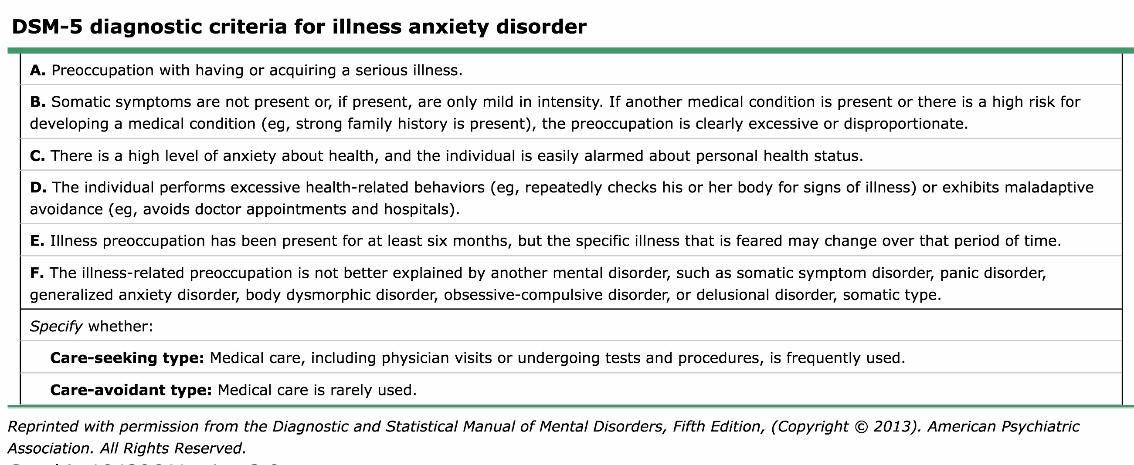
The diagnostic criteria for illness anxiety disorder
Notes:
History of present illness is vague and inconsistent.
●Health care concerns are rarely alleviated despite high utilization of medical care – Reassurance and explanation by clinicians that the symptoms are not caused by a serious general medical condition provides only temporary relief, or is viewed as a sign that the clinician does not understand the patient’s symptoms and is not taking them seriously
.●Multiple courses of standard treatment fail to mitigate the symptoms
.●Attributing normal physical sensations to medical illnesses
.●Repeatedly checking one’s body for abnormalities.
●Avoiding physical activity.
●Unusually high sensitivity to medication side effects.
●Seeking care from multiple doctors for the same somatic symptom(s).
●Clinicians find themselves feeling frustrated
●Refuses to grant permission to speak with other clinicians

Slide 45
Management
Patients with possible illness anxiety disorder are evaluated for
general medical conditions with a medical history, physical examination, and focused laboratory tests.
The psychiatric history and mental status examination should address the patient’s fears and beliefs about having a serious general medical illness, history of serious illnesses, current and past medical treatments, the quality of the patient’s relationship with current and past primary care clinicians, psychiatric comorbidity, psychosocial functioning, and family history of serious diseases.

Slide 46
The differential diagnosis
general medical disorders .
psychiatric disorders:
adjustment disorders.
somatic symptom disorder.
generalized anxiety disorder.
obsessive-compulsive disorder.
specific phobia, panic disorder.
body dysmorphic disorder
psychotic disorders.
depressive disorders.
Notes:
●In discussing the diagnosis of somatic symptom disorder with patients, clinicians should acknowledge their physical and emotional suffering, emphasize that the somatic symptoms are real, and should assure patients that the presence of a psychiatric disorder does not negate the reality of their suffering. When no general medical disorder has been identified, clinicians should avoid debating with patients whether the symptoms are due to psychiatric or nonpsychiatric illness. For patients with somatic symptom disorder that occurs in the context of an identified medical disorder, clinicians should not tell patients that they are blowing their symptoms out of proportion. .

Slide 47
General principles
Schedule regular visits.
Attempt to establish a collaborative therapeutic alliance with the patient
Acknowledge health fears
Communicate and coordinate care with other clinicians
Evaluate for and treat diagnosable general medical disease
Limit diagnostic tests and referrals to specialists
Reassure patients that serious medical diseases have been ruled out
Assess for and treat comorbid psychiatric disorders (eg, anxiety disorders, depressive disorders, and substance use disorders)
Educate patients about coping with health anxiety
Explicitly make functional improvement the goal of treatment

Slide 48
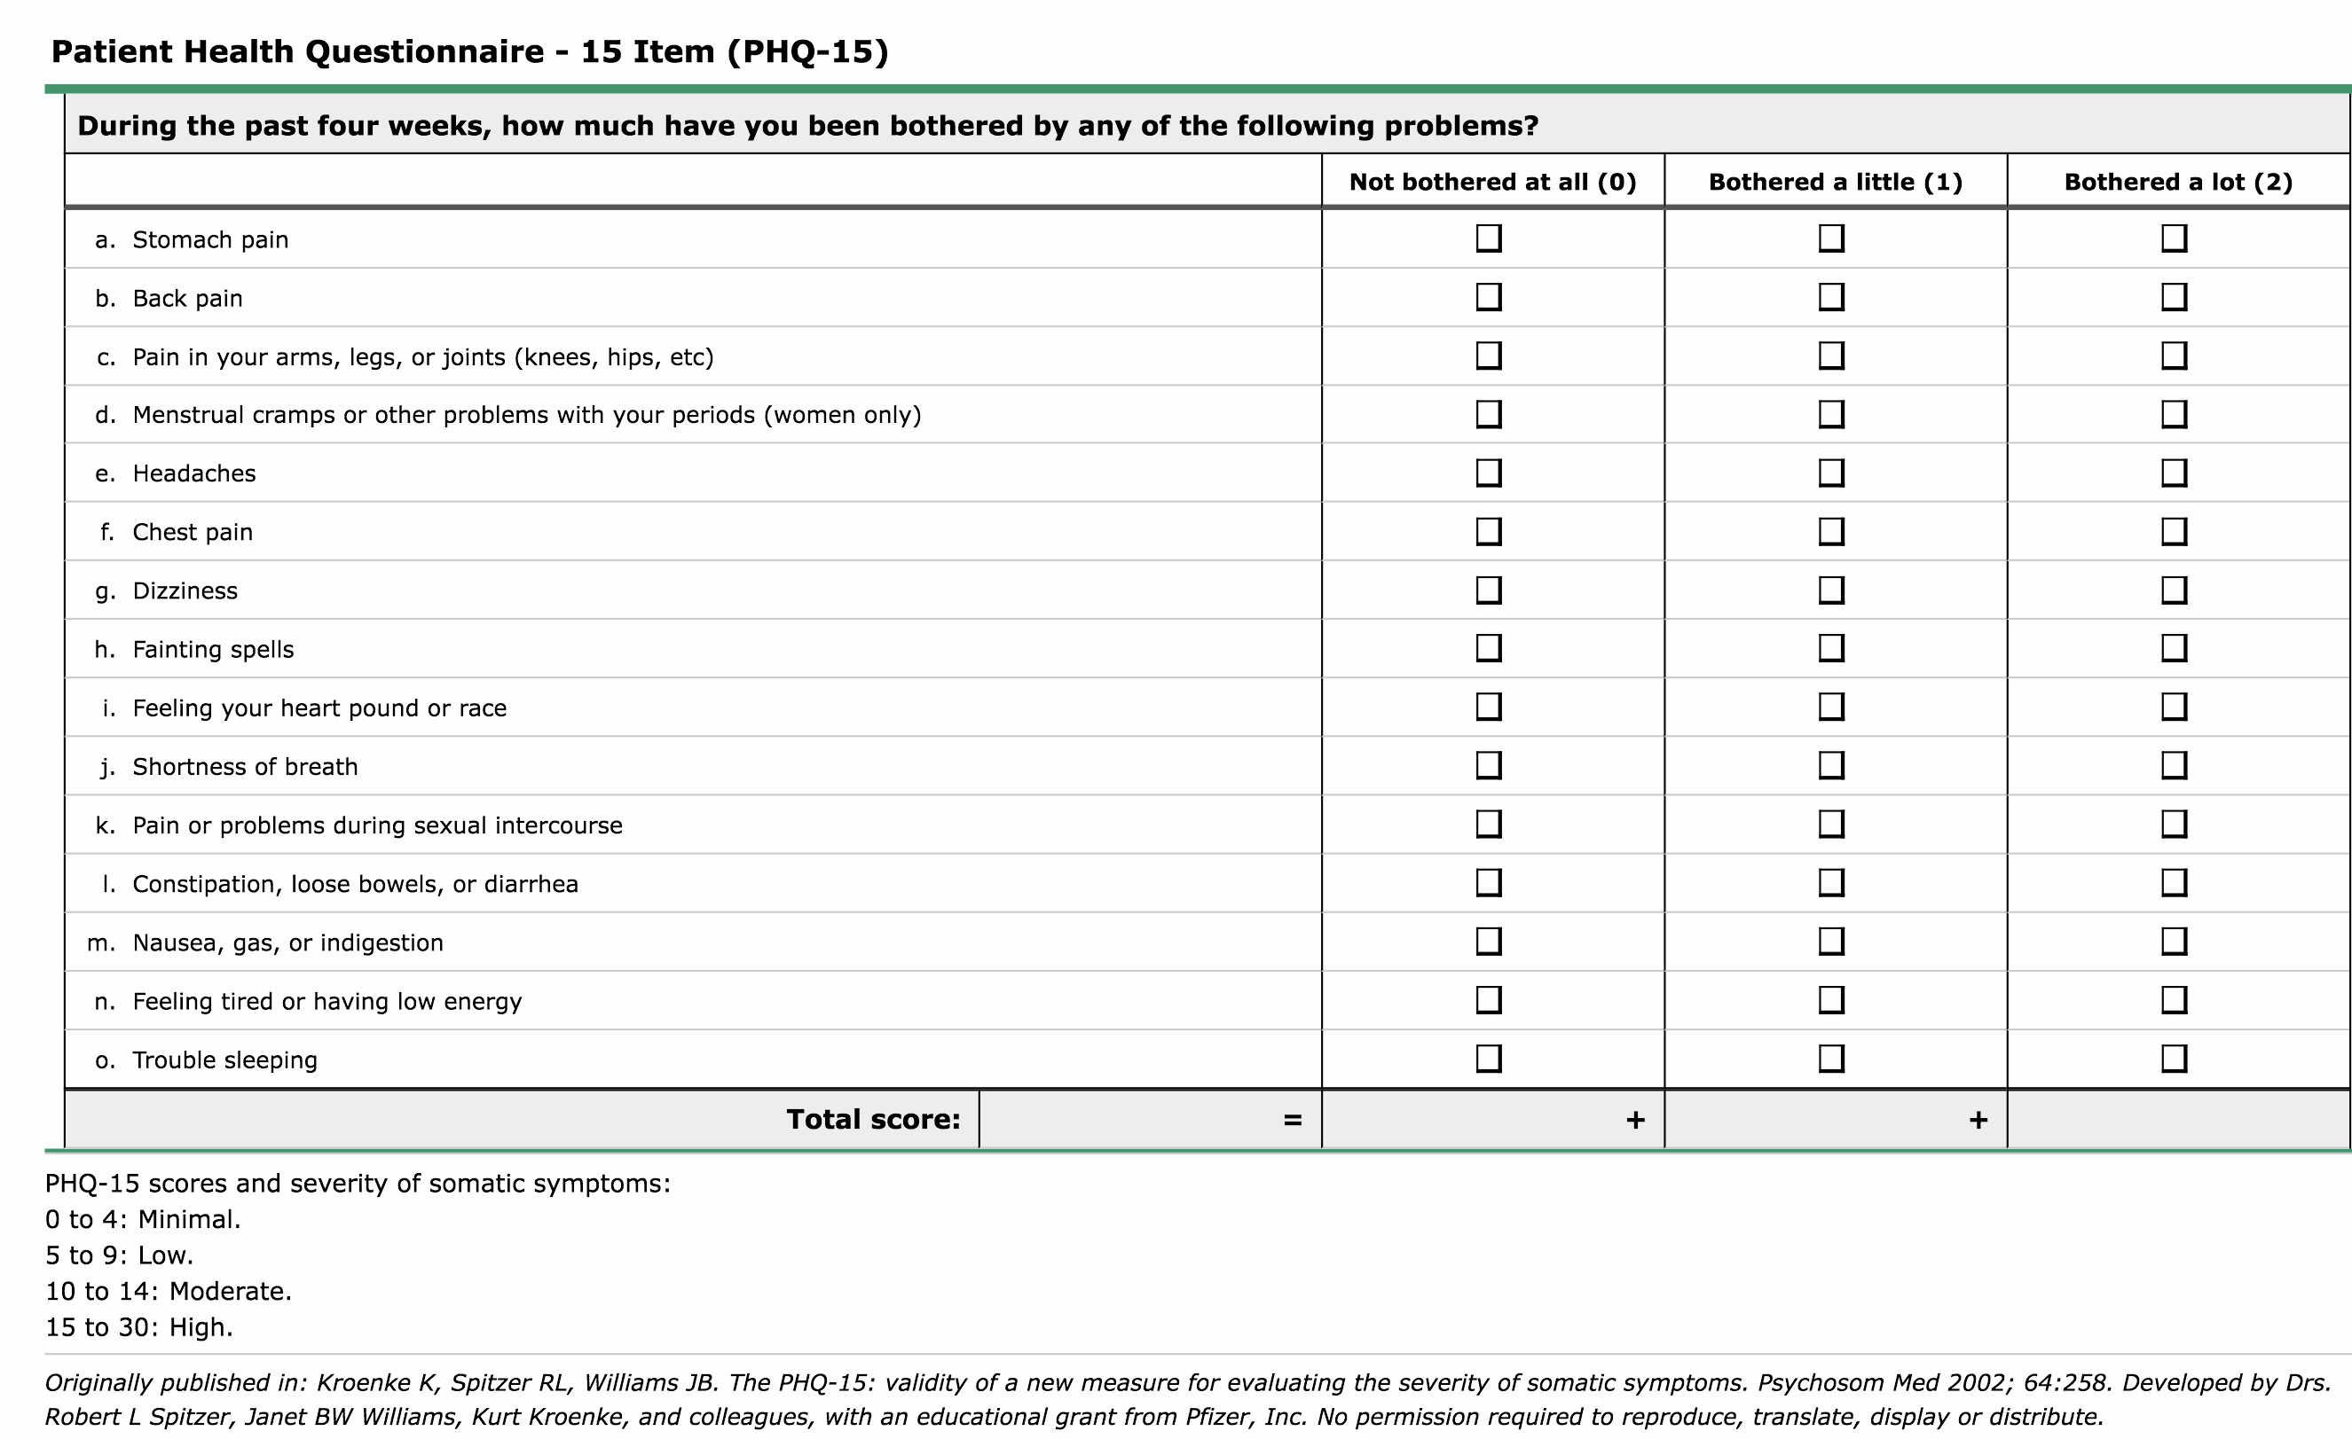

Slide 49
Referral . :referral to a psychiatrist or other primary mental health clinician for a consultation.
Notes:
to reduce diagnostic uncertainty and potentially harmful procedures and interventions.

Slide 50
Treatment
●First line : Cognitive-behavioral therapy
●Second line :different psychotherapy:
1). Mindfulness based cognitive therapy
2). Acceptance and commitment therapy.
3). Problem solving therapy
4 ) Relaxation training.
5) Behavioral stress management
●Third line : Antidepressant medication: SSRI : paroxetine & fluoxetine

Slide 51
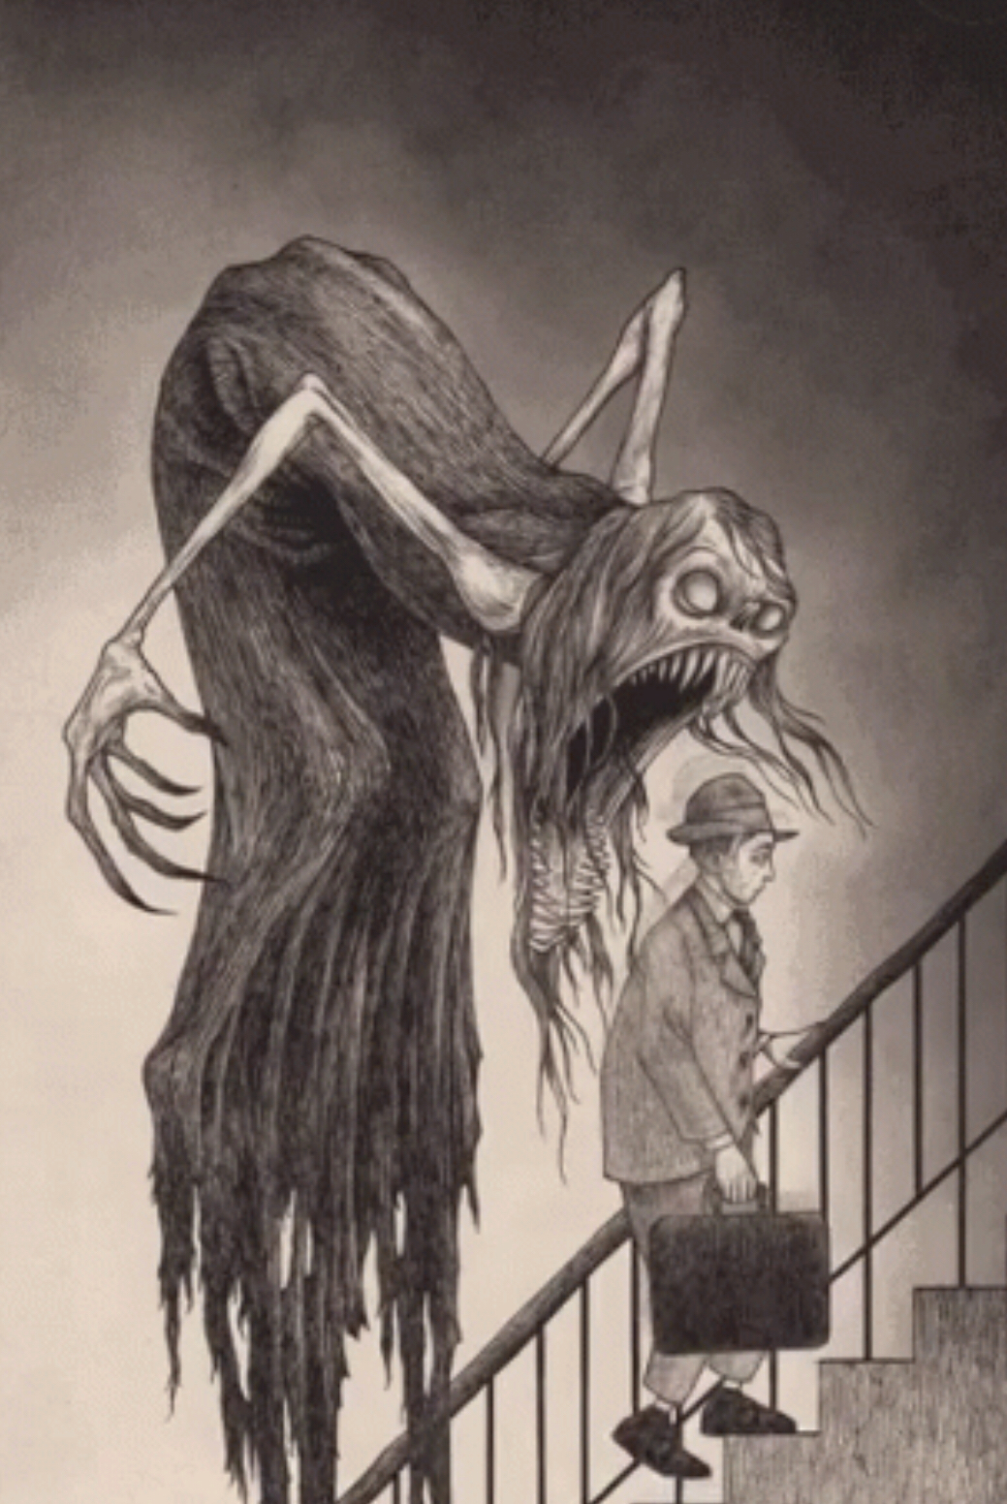
Notes:
The primary goal in managing illness anxiety disorder is to improve coping with health fears rather than eliminate them, and to prevent patients from adopting the sick role and becoming chronic invalids . Clinicians should focus upon caring rather than curing, while assuring patients that their concerns about illness have been heard and will receive appropriate evaluation. Patients should feel that their concerns are understood and not dismissed with statements such as "it’s all in your head."

Slide 52
Case # 4
Lyali 34 yr.old lady 2014
Frequent clinic visits due to dizziness. Followed by er visits
Dyspnea & s.o.b.
Palpitation
Numbness in one site of the face.
Heaviness in the tongue

Slide 53
Social history
Divorced, no children
Working in M.O.I
Smoker , 4-10c/day.
Frequent sick leaves.

Slide 54
Past medical history
No past surgical history.
Been hospitalized twice due to unwitnessed fits followed by l.o.c. & epilepsy??
Present history
Recurrent attacks of dizziness, last hours with normal balance
Mild epigastric pain & nausea
Headache , occipital heaviness in nature.
Palpitation. ,regular
Aggravated with lack of sleep or any social stressors .

Slide 55
Physical examination
We:49 kg , ht=153cm.
Bp=100/55, pulse:90b/m
Pulse=90 b/m , regular , symmetrical .
Afebrile , rbs=4.9mmol/l
Ear: normal
Chest : clear
Neurological examination : normal

Slide 56
What is your differential diagnosis?
Illness Anxiety disorder.
Somatic symptoms disorder.
Histrionic Personality disorders .
Panic attacks.

Slide 57
Panic attacks:
A panic attack is not a mental disorder. Panic attacks occur in the context of panic disorder, with other anxiety disorders, and with other mental disorders
(eg, depressive disorders, posttraumatic stress disorder, substance use disorders) and some medical conditions. When the presence of a panic attack is identified in conjunction with a mental disorder other than panic disorder, it should be noted as a specifier (eg, "posttraumatic stress disorder with panic attacks").

Slide 58
Panic attacks classically present with spontaneous, discrete episodes of intense fear that begin abruptly and last for several minutes to an hour.

Slide 59
In panic disorder, patients experience recurrent panic attacks, at least some of which are not triggered or expected, and one month or more of either worry about future attacks/consequences, or a significant maladaptive change in behavior related to the attacks, such as avoidance of the precipitating circumstances. The disturbance is not attributable to the physiological effects of a substance (eg, medication or illicit drug) or another medical condition (eg, hyperthyroidism, cardiopulmonary disorders).
Notes:
Agoraphobia was considered to be a complication of panic disorder in DSM-IV wherein an individual avoids situations for fear of developing a panic attack (“fear of fear”) [6,7]. The unlinking of panic disorder and agoraphobia in DSM-5 reflects the current conceptualization that agoraphobia is a distinct disorder that exists independently of the presence or absence of panic disorder [1,8,9]. Agoraphobia has also been conceptualized more broadly as a fear of difficulty in escaping [10].

Slide 60
DSM-5 diagnostic criteria for a panic attack :
An abrupt surge of intense fear or intense discomfort that reaches a peak within minutes, and during which time four or more of the following 13 symptoms occur:
Palpitations, pounding heart, or accelerated heart rate
Sweating
Trembling or shaking
Sensations of shortness of breath or smothering
Feelings of choking
Chest pain or discomfort
Nausea or abdominal distress
Feeling dizzy, unsteady, light-headed, or faint
Chills or heat sensation.
Paresthesias (numbness or tingling sensations)
Derealization (feelings of unreality) or depersonalization (being detached from oneself)
Fear of losing control or "going crazy"
Fear of dying
* The abrupt surge can occur from a calm state or an anxious state.

Slide 61
Management :
History and physical examination
A complete medical history, current life stress, separations, recent deaths, patient concerns and fears, interpersonal problems, recent substance abuse, and use of medications. The patient should be asked about avoidance patterns that have developed since the onset of panic attacks. Family members may provide valuable information overlooked or neglected by the patient.
Complete psychiatric ,physical and neurologic examination
Investigations:
standard laboratory testing (thyroid function tests, complete blood count, and a chemistry panel), (eg, an ECG , Holter monitoring) may be indicated based on age, family, and medical history.
Rating scales : Panic Disorder Severity Scale (PDSS)

Slide 62
Prior to making a diagnosis of panic disorder, Medical conditions that can mimic panic attacks should be excluded such as:
angina
arrhythmias,
asthma,
chronic obstructive pulmonary disease
pulmonary embolus
thyroid disease and,
temporal lobe epilepsy or
pheochromocytoma.
Substances that may trigger or worsen panic disorder include excessive caffeine use or the use of other stimulants, including certain drugs of abuse.

Slide 63
Treatment
based on clinical assessment of: Severity
the extent of distress or impairment .
patient preferences regarding treatment.
Mild panic disorder: education and reassurance with Clinical follow-up with the patient every six months to monitor the course of the disorder.
Moderate &severe panic disorder: CBT with or without SSRI

Slide 64
2019
Hypothyroidism on eltroxin.
Panic disorder on cipralix .
Histrionic Personality disorder.
Medical retirement.
single

Slide 65
Histrionic Personality disorder.
A pervasive pattern of excessive emotionality and attention seeking, beginning by early adulthood and present in a variety of contexts, as indicated by five (or more) of the following:
1. Is uncomfortable in situations in which he or she is not the center of attention.
2. Interaction with others is often characterized by inappropriate sexually seductive or provocative behavior.
3. Displays rapidly shifting and shallow expression of emotions.
4. Consistently uses physical appearance to draw attention to self.
5. Has a style of speech that is excessively impressionistic and lacking in detail.
6. Shows self-dramatization, theatricality, and exaggerated expression of emotion.
7. Is suggestible (ie, easily influenced by others or circumstances).
Notes:
معايير التشخيص الهستريونية - DSM-5 لاضطراب الشخصية الهستيرية هي كما يلي [1]: نمط واسع الانتشار من العاطفية المفرطة والبحث عن الاهتمام ، يبدأ من مرحلة البلوغ المبكر وموجود في مجموعة متنوعة من السياقات ، كما هو مبين في خمسة (أو أكثر) من التالية: ● 1. غير مريح في الحالات التي لا يكون هو أو هي مركز الاهتمام فيها. ● 2. غالبًا ما يتميز التفاعل مع الآخرين بسلوك مغر جنسيًا أو استفزازيًا. يعرض التحول بسرعة والتعبير الضحلة عن المشاعر. ● 4. يستخدم المظهر الجسدي باستمرار لجذب الانتباه إلى الذات. ● 5. لديه أسلوب حديث ذو انطباع مفرط ويفتقر إلى التفاصيل. يظهر التمثيل الذاتي والمسرحية والتعبير المبالغ فيه عن المشاعر. ● 7. ممكن (أي تتأثر بسهولة بالآخرين أو الظروف). ● 8. تعتبر العلاقات أكثر حميمية مما هي عليه بالفعل.

Slide 66
Treatment individual and group therapy, medication, self-education, specialized substance use disorder treatment, partial hospitalization, brief hospitalization during times of crises. Medications are generally used only as adjuncts to psychotherapy in patients with personality disorders.
Notes:
معايير التشخيص الهستريونية - DSM-5 لاضطراب الشخصية الهستيرية هي كما يلي [1]: نمط واسع الانتشار من العاطفية المفرطة والبحث عن الاهتمام ، يبدأ من مرحلة البلوغ المبكر وموجود في مجموعة متنوعة من السياقات ، كما هو مبين في خمسة (أو أكثر) من التالية: ● 1. غير مريح في الحالات التي لا يكون هو أو هي مركز الاهتمام فيها. ● 2. غالبًا ما يتميز التفاعل مع الآخرين بسلوك مغر جنسيًا أو استفزازيًا. يعرض التحول بسرعة والتعبير الضحلة عن المشاعر. ● 4. يستخدم المظهر الجسدي باستمرار لجذب الانتباه إلى الذات. ● 5. لديه أسلوب حديث ذو انطباع مفرط ويفتقر إلى التفاصيل. يظهر التمثيل الذاتي والمسرحية والتعبير المبالغ فيه عن المشاعر. ● 7. ممكن (أي تتأثر بسهولة بالآخرين أو الظروف). ● 8. تعتبر العلاقات أكثر حميمية مما هي عليه بالفعل.
Treatment
individual and group therapy,
medication,
self-education,
specialized substance use disorder treatment,
partial hospitalization,
brief hospitalization during times of crises.
Medications are generally used only as adjuncts to psychotherapy in patients with personality disorders.

Slide 67
2007 11 yr old girl presented with
Case # 5

Slide 68
Present history
Social history
Past history
Multiple cut wounds in the hands.
Superficial cut wound by a fruit knife.
Youngest girl in the family.
Good family dynamics.
Poor school performance with frequent changes in the school.
Nocturnal enuresis.
Fractured lower limb last month.
No past surgical history.
Normal pregnancy & postpartum.

Slide 69
2012-2015
Could not finish high school.
No close friends.
In conflict with her parents
reccarent car accident
Smoking marijuana
2012-2015

Slide 70
What is your differential diagnosis?
Learning disabilities.
Adhd
Bipolar disorder
Conduct disorder
Personality disorders

Slide 71
2019 23 yr old young lady
ADHD
Bipolar 2 disorder
Borderline p.d
Substance miss used

Slide 72
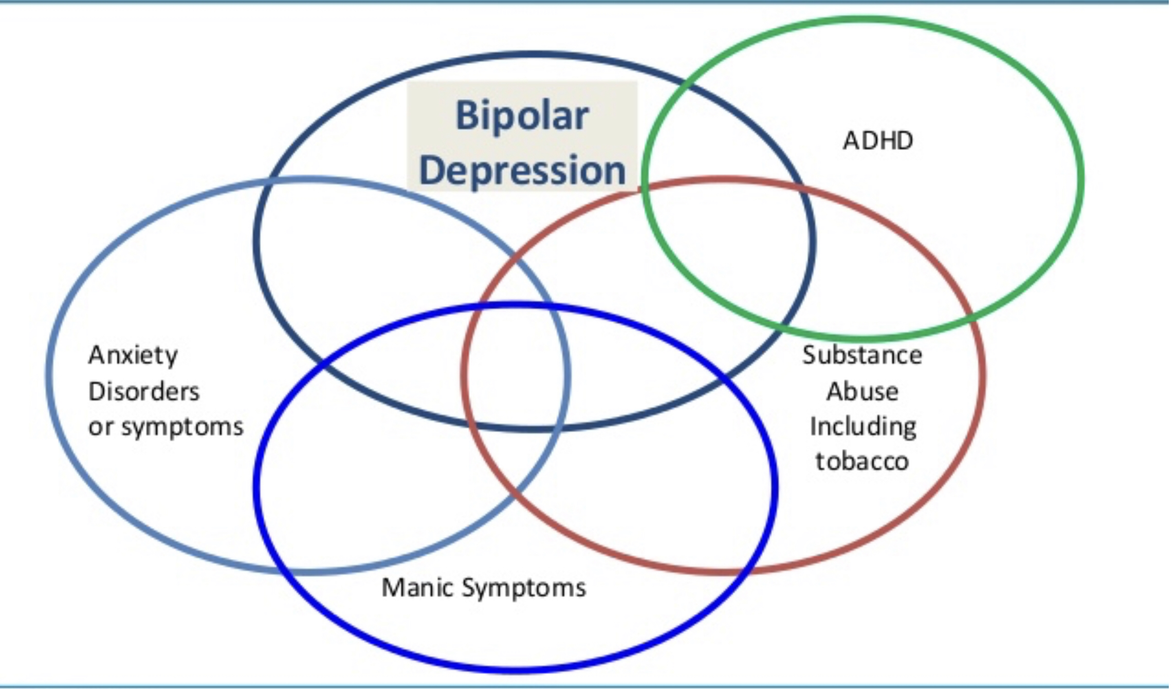

Slide 73
Borderline personality disorder
Frantic efforts to avoid real or imagined abandonment.
A pattern of unstable and intense interpersonal relationships characterized by alternating between extremes of idealization and devaluation.
Identity disturbance: markedly and persistently unstable self-image or sense of self.
Impulsivity in at least two areas that are potentially self-damaging (eg, spending, sex, substance abuse, reckless driving, binge eating).
Recurrent suicidal behavior, gestures, or threats, or self-mutilating behavior.
Affective instability due to a marked reactivity of mood (eg, intense episodic dysphoria, irritability, or anxiety usually lasting a few hours and only rarely more than a few days).
Chronic feelings of emptiness.
Inappropriate, intense anger or difficulty controlling anger (eg, frequent displays of temper, constant anger, recurrent physical fights).
Transient, stress-related paranoid ideation or severe dissociative symptoms.
Notes:
Affective instability.
Inappropriate anger.
Unstable relationships.
Feelings of emptiness.
Paranoia or dissociation.
Identity disturbance.
Abandonment fears.
Suicidality or self harm
جهود محمومة لتجنب التخلي الحقيقي أو المتخيل.
نمط من العلاقات الشخصية غير المستقرة والمكثفة التي تتميز بالتناوب بين التطرف المثالي والخفض.
اضطراب الهوية: صورة ذاتية ثابتة أو غير مستقرة أو إحساس بالذات.
الاندفاع في اثنين على الأقل من المجالات التي يحتمل أن تكون مضرة ذاتياً (على سبيل المثال ، الإنفاق ، الجنس ، تعاطي المخدرات ، القيادة المتهورة ، الأكل الشراعي).
السلوك الانتحاري المتكرر أو الإيماءات أو التهديدات أو السلوك المشوه.
عدم الاستقرار العاطفي الناجم عن تفاعل ملحوظ للمزاج (على سبيل المثال ، خلل النطق العرضي الشديد ، والتهيج ، أو القلق عادة ما يستغرق بضع ساعات ونادراً ما يكون أكثر من بضعة أيام فقط).
مشاعر مزمنة بالفراغ.
غضب شديد أو غير مناسب أو صعوبة في السيطرة على الغضب (على سبيل المثال ، عروض متكررة من المزاج والغضب المستمر والمعارك البدنية المتكررة).
عاطفية ، التفكير الإجهاد بجنون العظمة أو أعراض الانفصام الحاد.

Slide 74
 | ADHD | Bipolar disorder | Borderline P.D
Difintion | Neurobehavioral Disorder | Mood disorder | is a way of thinking, feeling and behaving that deviates from the expectations of the culture, causes distress or problems functioning, and lasts over time
Diagnostic criteria | Hyperactivity +/-Inattention Impulsivity occur in more than one setting and affect function (eg, academic, social, emotional, etc). | Episodes of: Mania Hypomania. Depression Mixed features. Psychosis | instability of interpersonal relationships, self-image, and emotions, as well as by impulsivity across .
Assessment | comprehensive medical, developmental, educational, and psychosocial evaluation | The initial clinical evaluation of psychiatric and general medical history, mental status and physical examination, and a basic set of laboratory tests | ===

Slide 75
Role of primary mental health care
Early diagnosis
Family counseling & psycho education of the course of the illness.
Treating depressive & anxiety phases & encourage patient on compliance.( during times of crises.)
Management of associated medical co morbidity.( std,NCD)
Life long relation ship.

Slide 76
Case # 6
Adel is 50 yr.old ,Business Man
Hypertension
Presented with neck pain, jaw pain.

Slide 77
NCD clinic
Recurrent attacks of jaw pain lasting hours, associated with sore throat , no fever, no cough, neck pain headach &insomnia
Frequent in the last 8 months.
Uncontrolled bp

Slide 78
Present history
Social history
Past medical history
Jaw pain shocking like pain
Mild to moderate in severity. mainly at night.
Associated with sweating & palpitations, exertion dyspnea.
Good compliance to his medication
Business Man, frequent traveler.
Married having 2 sons, one of them diabetic type 1 . He is worried a lot about his blood sugar level.
His father recently died from heart attacks.
Not smoker .
Holter ,ecg , echo done normal.
Upper gi endoscopy normal
Cholysestoctomy 2011
Hypertension ,hypercholestremia.

Slide 79
What is your differential diagnosis?
Illness anxiety disorder
somatic symptom disorder.
Panic attacks or disorder
Generalizes anxiety disorder.

Slide 80
Generalized anxiety disorder (GAD) is characterized by excessive worry and anxiety that are difficult to control, cause significant distress and impairment, and occur on more days than not.Generalized anxiety disorder is a relatively common disorder, most often with an adult onset and chronic course

Slide 81
Clinical features:
excessive and persistent worrying ,greater worry over minor matters
symptoms relating to hyperarousal, autonomic hyperactivity and muscle tension.
poor sleep, fatigue and difficulty relaxing.
Headaches and pain in the neck, shoulders, and back
present to health professionals repeatedly
Patients with GAD typically respond positively to the question, “Do you worry excessively about minor matters?”, while a negative response should rule out the diagnosis of GAD .

Slide 82
Management:
Assessment of a patient with possible GAD should include :
A careful history and an evaluation for symptoms of GAD
as well as alternative or co-occurring medical conditions, including psychiatric disorders.
physical exam and laboratory studies to rule out organic causes of anxiety.
The generalized anxiety disorder seven-item (GAD-7) scale:

Slide 83
Treatment:
Treatment with a SSRI or SNRI antidepressant, cognitive-behavioral therapy (CBT), or both.

Slide 84
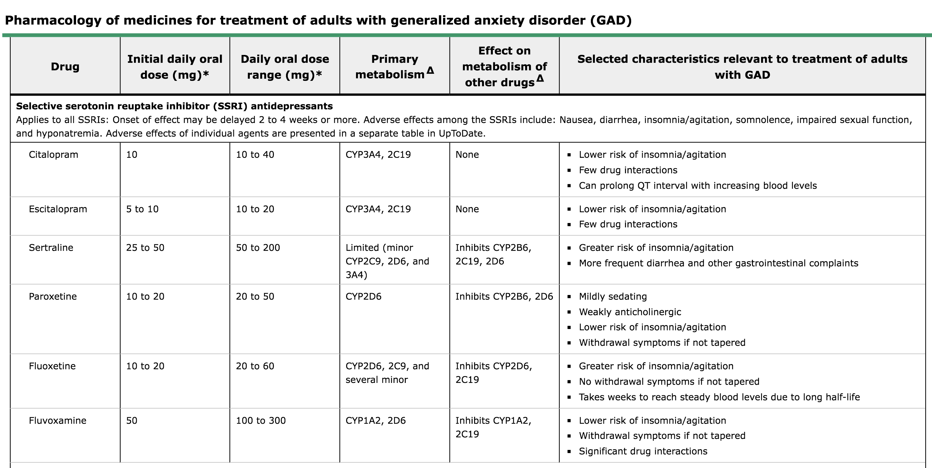

Slide 85
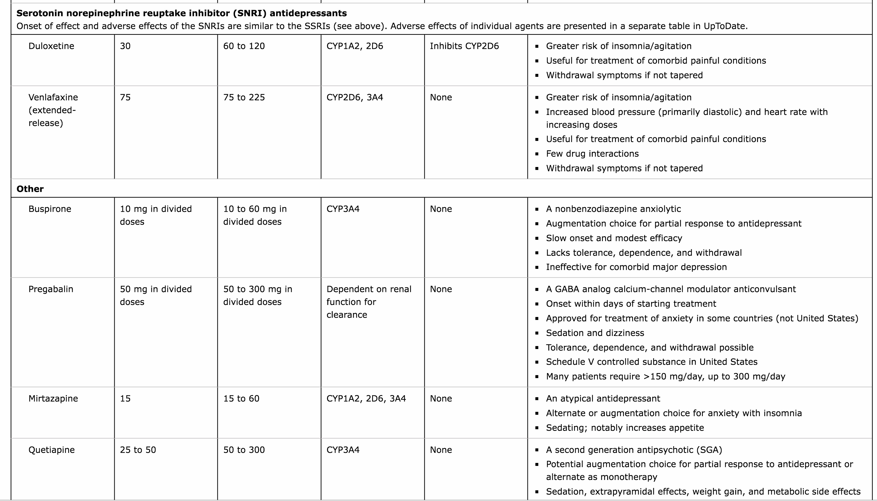

Slide 86
TREATMENT RESPONSE
No response:
Partial response:
Robust response :

Slide 88
Generalized anxiety disorder
Hypertension.

